Slide 1

Heritage Policy and Practices
LEANZ Fellowship Presentation
Philip Barry
Wellington
November 12, 2025

Slide 2
Introduction
Opening and thanks
Historical and Intellectual context
Notes:
Architectural importance: “Tudor” and “Stick” style;
-engaged architect: said references to Tudor were completely misleading ; not a good representation of the Stick style and if it ever was its been heavily modified over the last 100 + years anyway:
- Historical importance: Chief inspector of mines

Slide 3
Introduction
Mandatory heritage designation
My involvement
The Voluntary Heritage Group
Disclosure of interests
Notes:
Architectural importance: “Tudor” and “Stick” style;
-engaged architect: said references to Tudor were completely misleading ; not a good representation of the Stick style and if it ever was its been heavily modified over the last 100 + years anyway:
- Historical importance: Chief inspector of mines

Slide 4
Notes:
Not Thomas Jefferson
Irish barrister and orator who argued for freedom of the press and Catholic emancipation

Slide 5
Contents
Framework
Is the current heritage system working
What is the problem
The causes of the problem
The experiences in different parts of the country
A better approach
Conclusions

Slide 6
Framework
Comparative institutional analysis
Market failure:
Externalities – public benefits of heritage
Public failure:
Bureaucratic drive
Lobbying for regulatory takings – a free resource
Private solutions:
Property rights
Private contracting - costly
Relative transaction costs
Aim: align incentives
Facilitate market solutions

Slide 7
The Current System
RMA Section 6: Matters of national importance:
(f) the protection of historic heritage from inappropriate subdivision, use, and development
Heritage NZ
Lists 6,000 properties across the country
Owns 45 properties
Anyone can nominate a property to add to the list – the owner is also consulted
Listing is nominal- in itself it imposes no constraints or duties on the owner
Council policies
It’s individual council’s policies that matter
- Individual heritage properties
- Heritage areas
- Special character areas

Slide 8
What Does it Mean to be Heritage-Designated?
Practices vary from Council to Council but typically heritage designation means the owner needs to seek a consent to:
Change any part of the exterior of the building as seen from the road
Alter windows and window frames
Change the cladding
Remove an unsafe chimney
Add solar panels
Add an extra story or room
Demolish the building
Develop the property
Obtaining the consent is costly, time consuming and by no means guaranteed

Slide 9
Councils’ Policies and Practices
In 2022 VHG surveyed 67 councils: 59 responded to our query focused on individual heritage-designated properties
Councils differ widely in their policies and practices
19 councils do not heritage-list any private properties
10 councils do not list any properties other than HNZ-designated properties
5 councils require owner consent to a listing: Hastings, Hurunui, Ruapehu, Waimate, Waitaki
5 councils list private residential properties, but changes to them are permitted if notice given to the council
9 councils list additional properties, but do not list additional private residential properties
Other councils either mandate heritage designation or are unsure about whether they would need owner consent

Slide 10
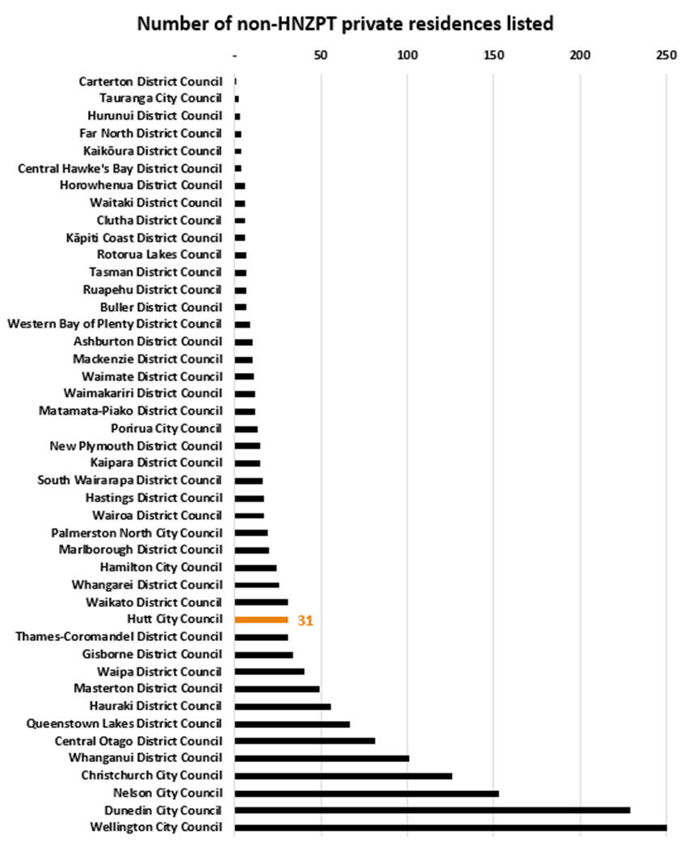
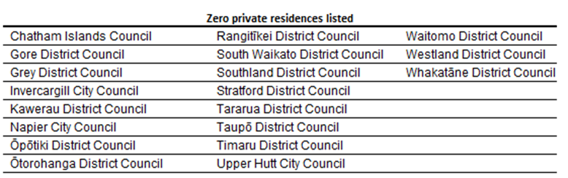
Councils’ Policies and Practices
Notes:
Notable omission: Auckland Council - they did not know how many properties they designated
Auckland Council’s 2024 Heritage Counts says there are 2,459 historic heritage places and 22 historic heritage areas protected in the Auckland Unitary Plan / Hauraki Gulf Islands District Plan – this does not include properties in Special Character Areas
Special Character Areas (SCAs) are a separate overlay and are reported separately—Heritage Counts lists 50 SCAs and notes that about 5% of Auckland property parcels are within SCAs.
Auckland Council’s Plan Change 78 material says SCAs include “over 21,000” residential properties and ~1,600 business properties → ≈ 22,600 properties
Welington Character areas: WCC s42A report table shows ODP 5,900 → PDP (notified) 2,207 → around 3,293 properties across Thorndon, Mt Victoria, Aro, Kelburn, Mt Cook, Berhampore, Newtown.
Chch, Hamilton, Napier, Hasting, Kapiti, Queensland and Whanganui Councils also have character areas. Numbers of properties covered not know.

Slide 11
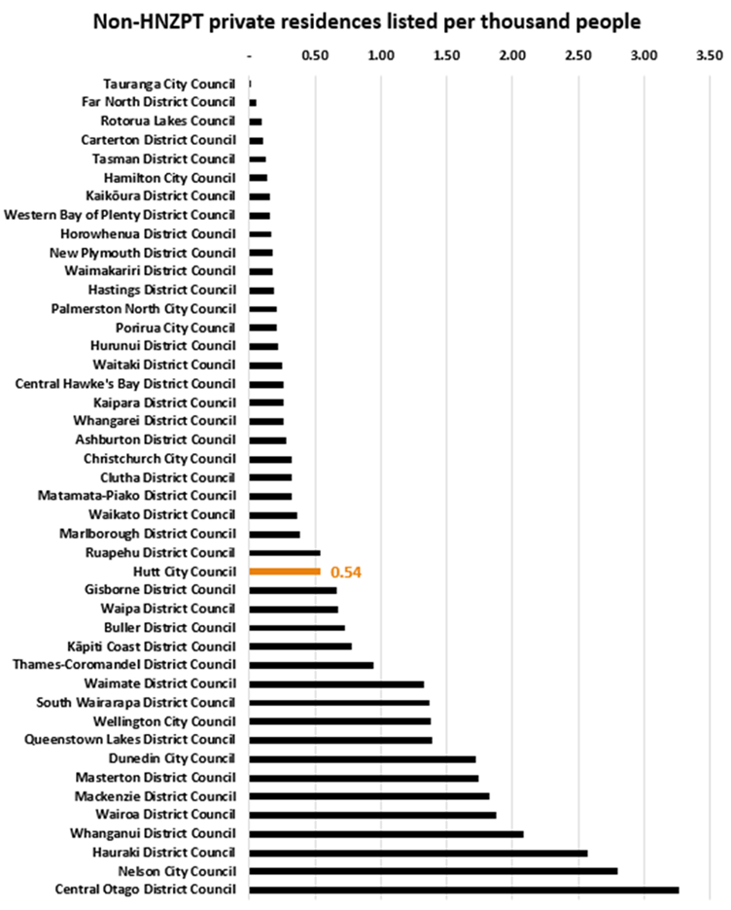
Councils’ Policies and Practices

Slide 12
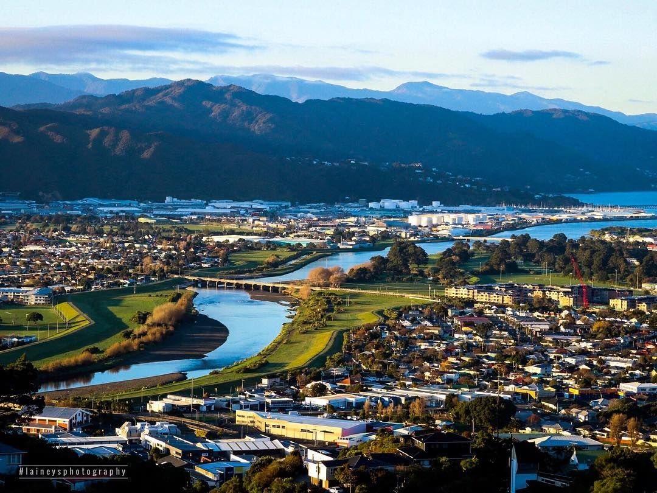
Is the current heritage system working?
Is it protecting national heritage?
Is it imposing unnecessary costs on homeowners?
Is it undermining housing affordability?

Slide 13
The Problems
The current heritage system is not working well
True national heritage is not being protected
Thousands of peoples’ homes are being heritage-designated falsely

Slide 14
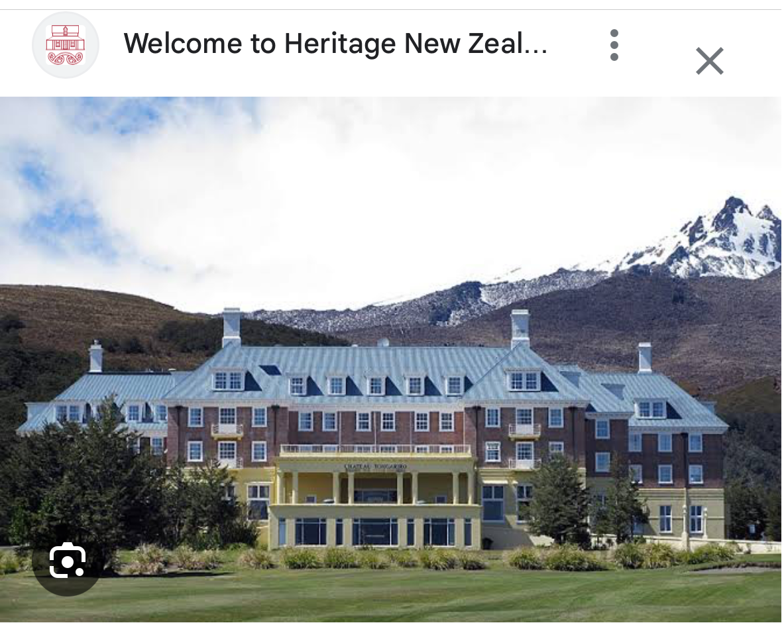
Our National Heritage is Not Being Well Protected
Much of our true national heritage is being neglected and falling into disrepair
Heritage NZ is not adequately funded
It resorts to regulation
But regulation without compensation doesn’t work

Slide 15
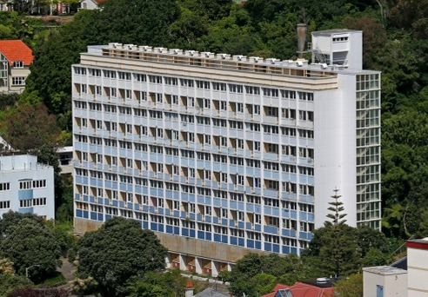
Our National Heritage is Not Being Well Protected
Much of our heritage is being neglected and falling into disrepair

Slide 16
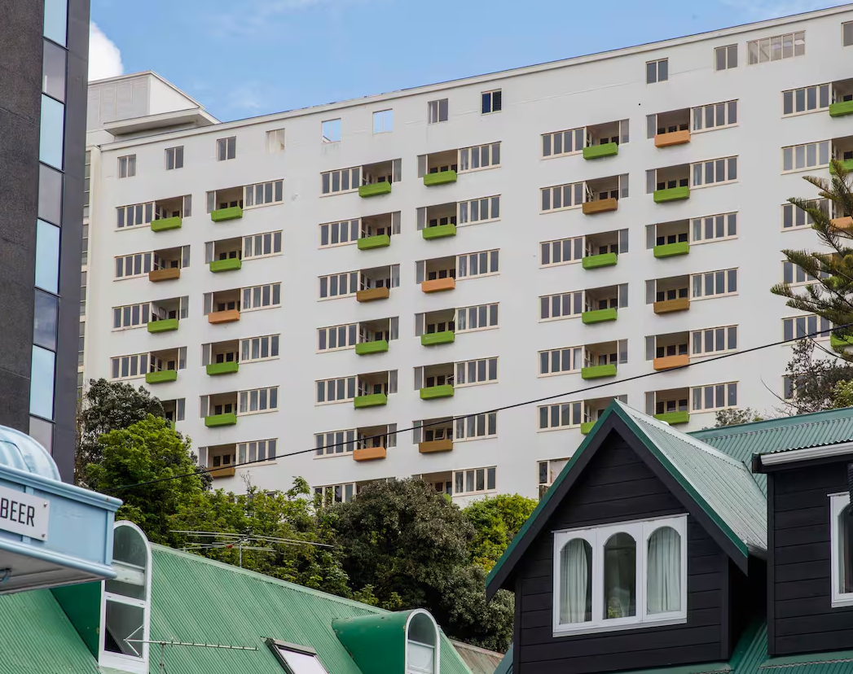
Our Heritage is Not Being Well Protected
Dixon St flats – boarded up, left empty and left to rot
- Sold for $1.04m
Notes:
107 apartments, KO owned, closed in 2022. Cost of remedial/strengthening work estimated at $125m.
Can’t demolish as heritage: Category 1 Historic Place
2025: Sold in Taranaki Whanui Ltd for $1.04m (assessed market value $4m and RV of $18.9m) under iwi’s first right of refusal
Taranaki Whanui resold to the Wellington Company four weeks later for $3m – plan to develop 117 apartments

Slide 17
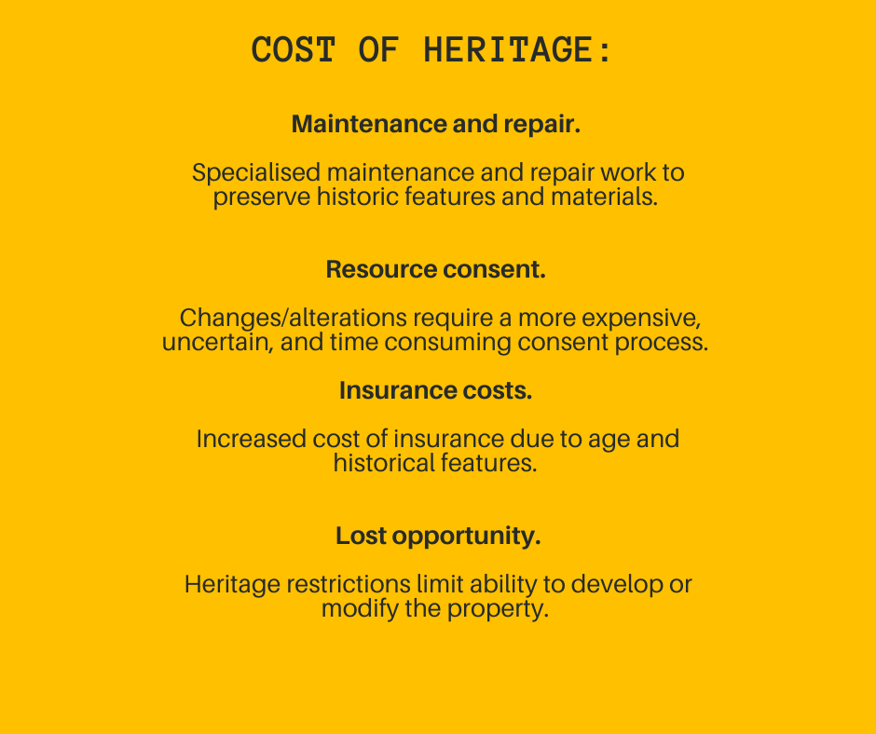

Slide 18
Heritage Designations – the Value Implications
Three key published studies:
1. “The price premium of heritage in the housing market: evidence from Auckland, New Zealand”, Bade et al, Land Use Policy 99 (2020)
Approach: Uses a hedonic pricing model to investigate how “heritage” status affects house prices in Auckland, New Zealand
Controls for characteristics such as location, size, age, and market conditions
Uses a dataset of 226,286 sales between 2006 and 2016
Findings: A statistically significant price penalty of around -9.6% for houses protected for heritage
A price premium of around 1.7% for houses neigbouring the heritage designated property

Slide 19
Heritage Designations – the Value Implications
2. “Making - or Picking - Winners: Evidence of Internal and External Price Effects in Historic Preservation Policies”, D S Noonan and DJ Kupta, Journal of Real Estate Economics, March 2011
Approach: Examine approx. 60,000 homes in Chicago in 1990s
Control for endogeneity (policy-makers picking winners)
Findings: In the 2SLS hedonic, estimates of the “own” price effect of historic designation are shown to be large and negative (approx. -27%) for homes in landmark districts.
Properties with objectively higher historic quality sell at premiums. The negative effects are tied to the policy restrictions, not to the historic attributes being preserved.

Slide 20
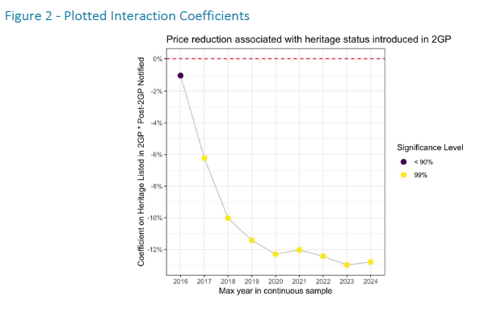
Heritage Designations – the Value Implications
3. “Economic Impact of Heritage Protections on Selected Properties”, m.e consulting, March 2025
Approach: Dunedin‑wide price‑trend analysis to infer the typical price impact associated with heritage scheduling
Findings: heritage designation associated with average real price reductions of around 13% over the medium term

Slide 21

These costs are encapsulated in the likely decline in the value of the homes of 10% to 30% or more.
Real Estate Agents have advised that heritage designated homes are more difficult to sell, and many buyers withdraw interest when they learn it is heritage designated.
Even a 10% value reduction on an average home worth $1m means a $100,000 price reduction.
Across 3,000 houses that’s $300m of value lost.

Slide 22
Case Study 1: Hutt City
Currently: 4 heritage areas (approx. 90 homes) plus 114 individual properties heritage-designated
Date | Event
2011 | Council proposed adding approx. 160 properties to its heritage list
2012 | Council backed down Council decided to only list with owners consent But the policy never made it to District Plan
2021-22 | New heritage policy
2022-23 | Plan Change 56 (response to Housing Supply Act) proposed six new heritage areas with 350 extra heritage homes Independent Commission ruled against additional heritage designations
2024-25 | District Plan Change proposed adding another approx. 72 properties to heritage list Government put all Plan changes on ice
Allocated $1.5 million over next 10 years for the Built Heritage Incentive Fund
Notes:
rust never sleeps
The price of freedom is eternal vigilance

Slide 23
Fake heritage is growing
Independent expert Neil Kemp – a registered architect with over 40 years professional experience
Mr Kemp examined the properties in Hutt PC56 and concluded:
“Hutt City Council cannot rely on the evidence provided by the Council’s expert as it has not demonstrated the areas have significant heritage value.”
“The great majority of the homes in the proposed new areas have been significantly modified over time and are devoid of heritage value.“

Slide 24
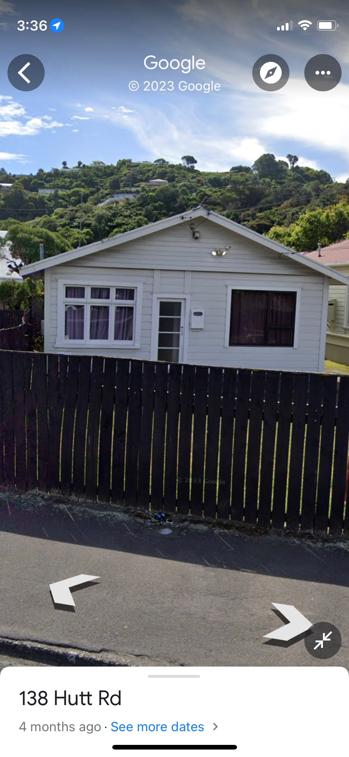
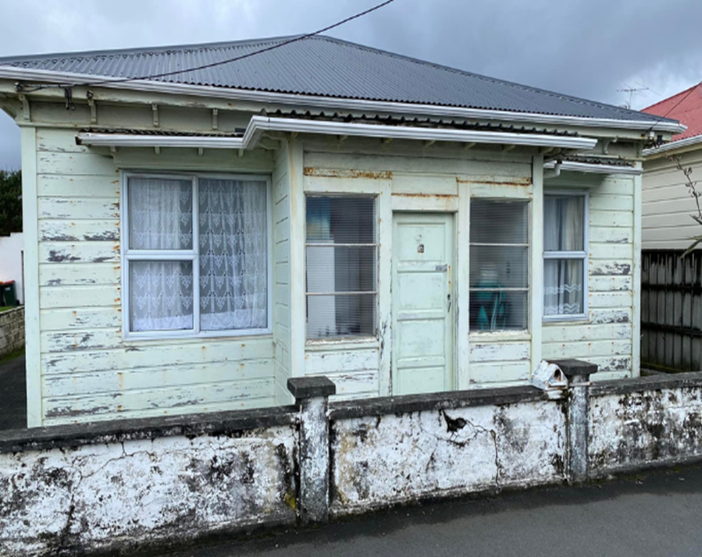
73 Hutt Road, Petone.
In the proposed heritage areas (HA-03).
45 Queen Street, Petone.
In the proposed heritage areas (HA-08).

Slide 25
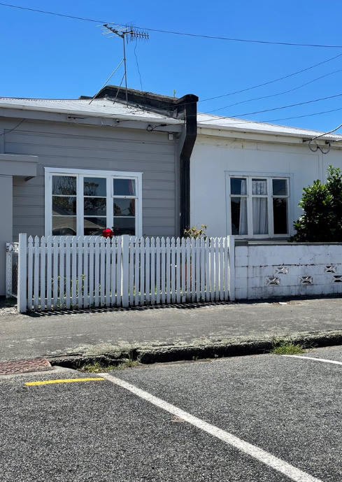
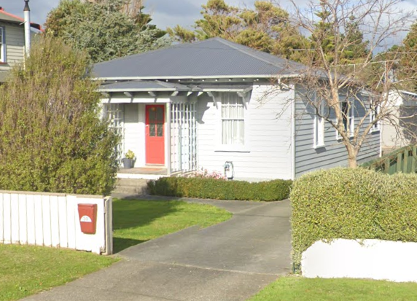
6 & 8 Hector Street, Petone.
In the proposed heritage areas (HA-03).
30 Elizabeth Street, Moera.
In the proposed heritage areas (HA-07).

Slide 26
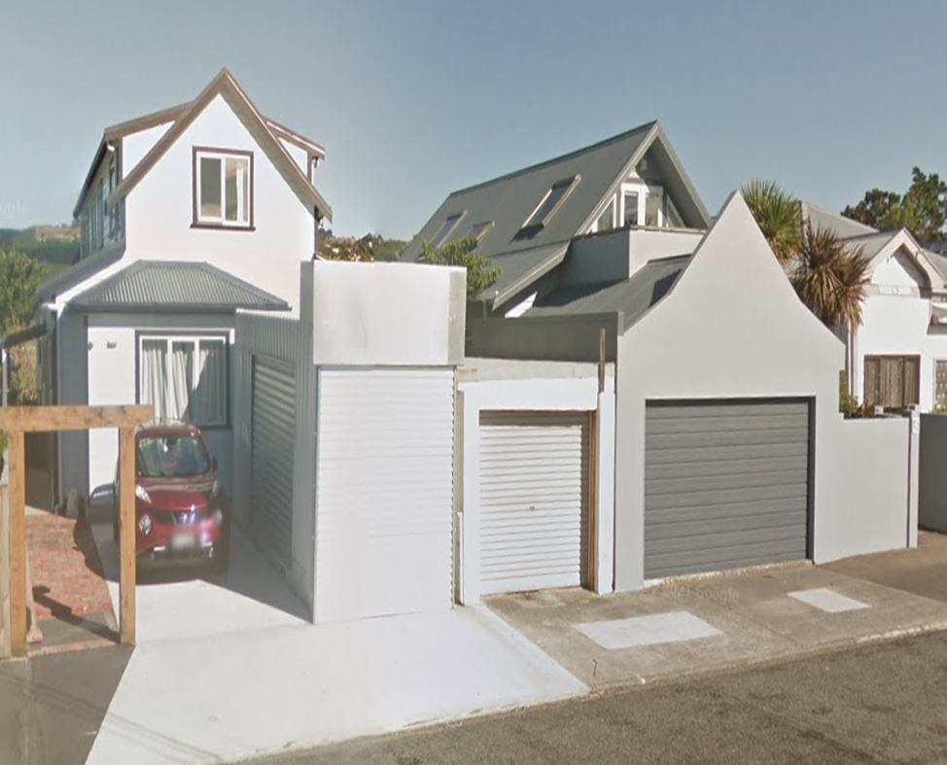
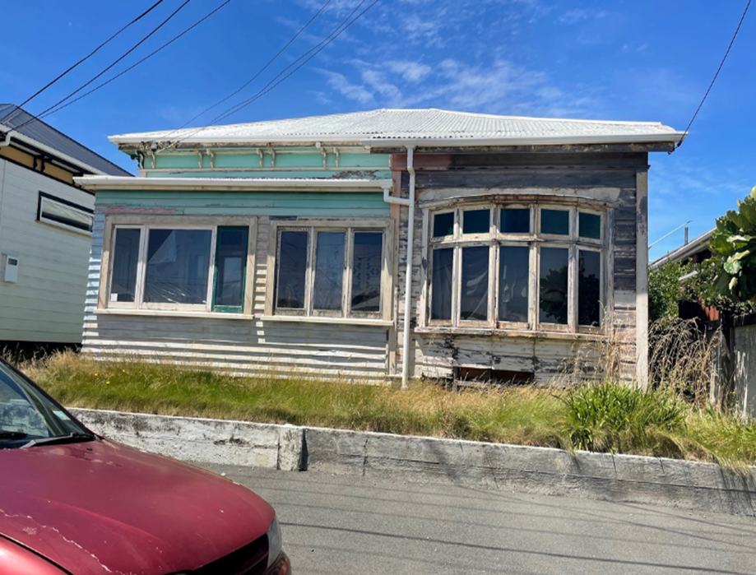
3 & 5 Bolton Street, Petone.
In the proposed heritage areas (HA-08).
4 Queen Street, Petone.
In the proposed heritage areas (HA-08).

Slide 27
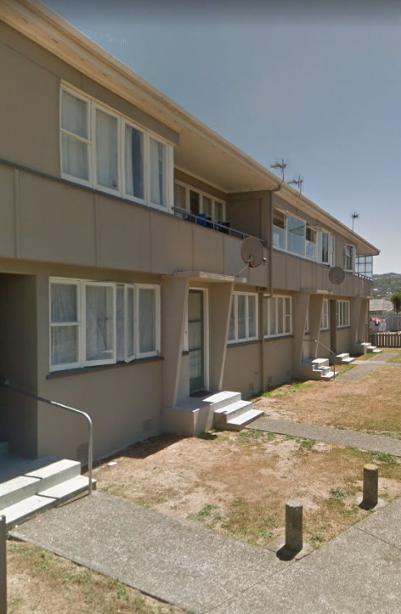
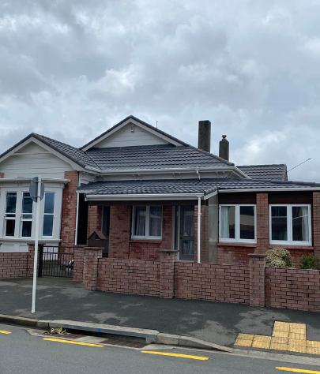
Hardham Crescent, Petone.
In the proposed heritage areas (HA-01).
2 Queen Street, Petone.
In the proposed heritage areas (HA-08).

Slide 28
In 2023, Hamilton City Council proposed 32 new historic heritage areas (HHAs) containing around 3,000 properties
Minimal and at times no evidence was provided of the properties’ heritage values
In a later report, the expert said that he was not given time or resources to do research
But all properties were publicly notified with restrictions including no solid fences over 1.2m
Many were unsaleable as the HHA precluded significant renovation or demolition.
Case Study 2: Hamilton

Slide 29
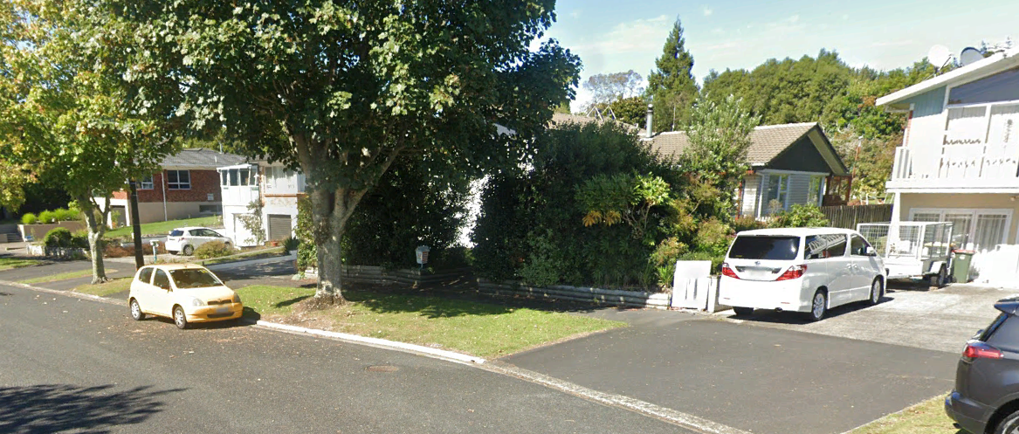
These houses are described as exhibiting “High heritage significance as it is a relatively unaltered example of 1960s/1970s development.”
Fake heritage – Acacia HHA, Hamilton

Slide 30
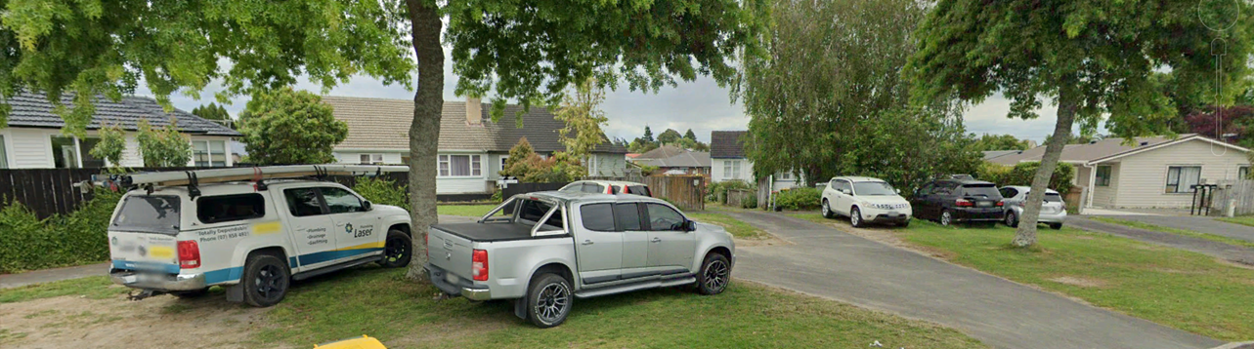
Fake heritage – Fairfield Rd, Hamilton
Fairfield Project has about 800 state houses
Nothing differentiates the selected homes from the rest of 1950s state housing streets in the suburb.

Slide 31
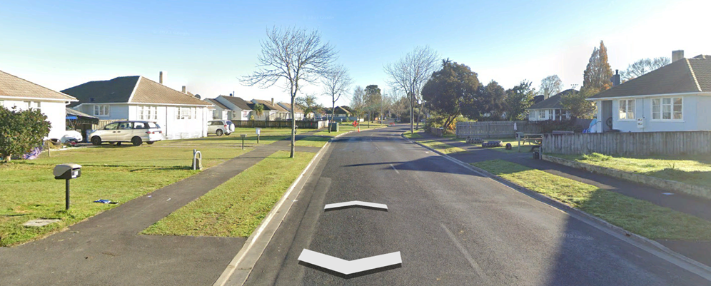
Fake Heritage – Sare Rd, Hamilton
The area is claimed “to exhibit High heritage significance as it is a relatively unaltered example of post-war development. The curving street design moves away from the previously regimented grid street layouts to the post-war free flowing street form which typifies the period.”

Slide 32
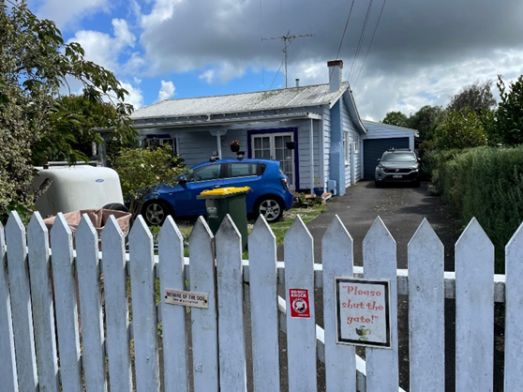
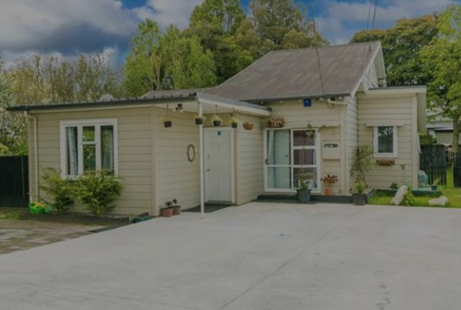
Fake heritage – Oxford East, Hamilton
A group of 12 houses (of which these two are typical) were incorrectly recorded in an expert report as “appear to be railway cottages” and so they met the theme “representative of a railways workers suburb”. They are not Railway houses, have nothing to do with Railways and are several kilometres from any rail infrastructure.
The experts then decided they were early 1920s Ellis and Burnand prefabricated houses which a) they are not but also E & B did not design until the late 1920s.

Slide 33
Dunedin
Greytown
Napier
Other Case Studies
Notes:
Imbalance of power and information
Dunedin City Council Plan Change 1 (PC1) has added approx. 130 properties to the council's heritage schedule. Some are under appeal to Environment Court.
Most homeowners didn’t know the implications of a heritage listing until it was too late. Many receive just a letter and then find themselves dealing with increased maintenance costs, decreased property value, and restrictions on what they can do with their own property.
On the other hand, the council has teams of full-time staff and experts who are fully resourced to push the heritage listings through. Most homeowners simply don’t have the time, resources, or energy to contest these proposals and end up accepting the heritage listing, even though it could have significant financial consequences.
If there were a cost to the council for every heritage listing, such as fully purchasing the property, then they would be far more scrupulous with their decisions. Instead, the current system allows them to take a shotgun approach, slapping heritage listings on properties with very broad and arbitrary criteria.
Greytown: self-appointed heritage group – one of our members had to spend $30k and 3 years defending property – and nothing stops group having another go next time
Napier: similar story

Slide 34

The root cause of the problems
The RMA
Section 6 of RMA: Matters of national importance:
  “Councils must recognise and provide for … the protection of historic heritage from inappropriate subdivision, use and development”
Many Councils believe they have a legal obligation to designate properties as heritage, even without the owners’ agreement

Slide 35
The Incentives Are All Wrong
Those who benefit from heritage designations bear none of the costs
Those who bear the costs and losses get few if any benefits
If there is a true public benefit from heritage designation shouldn’t the public pay?

Slide 36
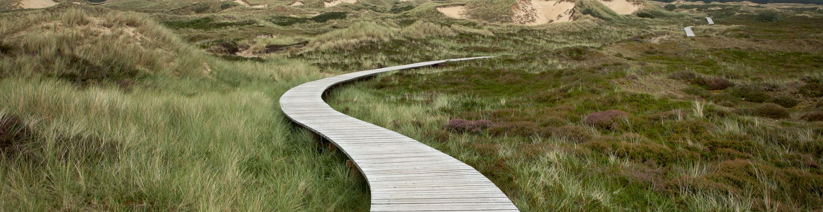
A better way
There is a better way
To recognise and protect private property rights in the RMA.
To allow Councils to make new designations of private property as heritage only with the consent of the property owner.
The one exception should be true national heritage identified by Heritage NZ and only if the owners are fully compensated
Heritage NZ not to have regulatory-takings powers but to be funded adequately and to be required to live within its budget

Slide 37
A better way
Budget constraint internalises the externalities
And is more transparent
Permits voluntary solutions:
  Eg, Councils can subsidise or own local heritage

Slide 38
The bigger picture – of RSBs, SNAs and SASMs
The Regulatory Standards Bill provides some recognition for property rights
However, an impairment or partial taking will only be deemed to be inconsistent if it is “severe” and if ‘fair’ compensation is not to be provided.
Significant Natural Areas raise the same concerns as Heritage designations
As do Sites and Areas of Significance to Māori
Notes:
Similar issues arise with SNAs and SASMs designations on private property

Slide 39
Conclusions
The current heritage system is not fit for purpose
  True heritage is not being adequately protected
  Fake heritage designation are imposing large costs on property owners and undermining housing affordability
There is a simple fix – publicly fund true national heritage designations by HNZ while protecting private property rights under the RMA
So that councils can only heritage-designate with the agreement of the property owner
That will mean better protection of true national heritage, greater security of property rights for home owners and more affordable housing

