Slide 1
Smokefree 2025: Toward a better policy framework
Dr Eric Crampton
The New Zealand Initiative
Law & Economics Association New Zealand
24 September 2019

Slide 2
Reaching the target, without aiming at it
Targeting trivially low smoking rates by 2025 risks doing harm;
Setting appropriate policy for reduced-harm alternatives is good for its own sake, and will also reduce smoking rates

Slide 3
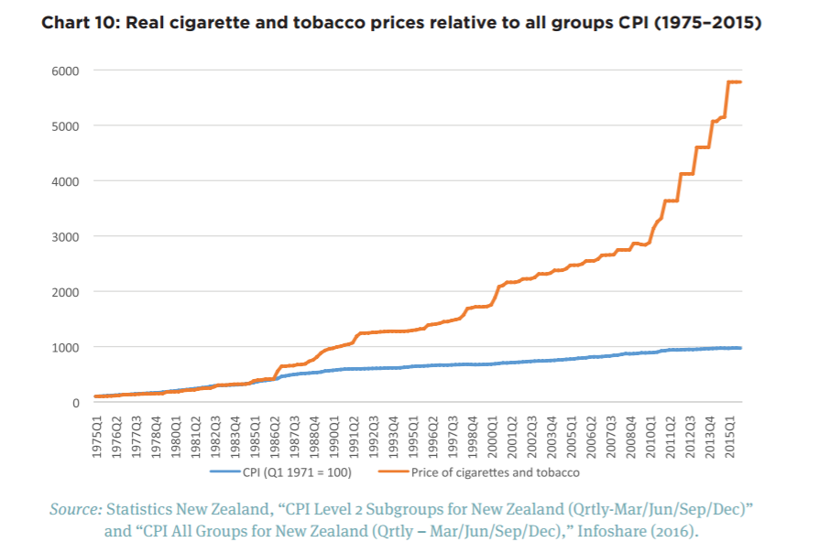
Harms and the current policy path

Slide 4
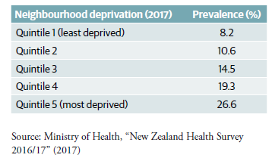
Harms and the current policy path
Tobacco excise of $0.94 per cigarette = $6,752.50 per year for a pack-a-day smoker
Quintile 5 income: $41,000
A pack a day is equivalent to 16% of that household’s income
Notes:
Before housing cost household income for a couple with two kids: $41,000 puts you at the boundary between deciles 1 & 2. So a pack-a-day smoker in that household is paying 16% of the household income in tobacco excise.

Slide 5
Harms and the current policy path
National’s excise increases highly regressive
For every 1000 Māori:
  773 would not have smoked regardless
  13 would have quit because of the excise hikes
  214 cut their smoking by 10%, and pay $1020 more per year in excise
Notes:
Work here based on the estimates provided at the Public Health Expert blog, described here:
https://offsettingbehaviour.blogspot.com/2016/06/tobacco-excise-running-numbers.html

Slide 6
Harms and the current policy path
Smoked tobacco is widely available, highly taxed, and use is highly regulated
Vaping soon to be highly regulated, limiting uptake
Heated tobacco is taxed and highly regulated
Snus is effectively unavailable

Slide 7
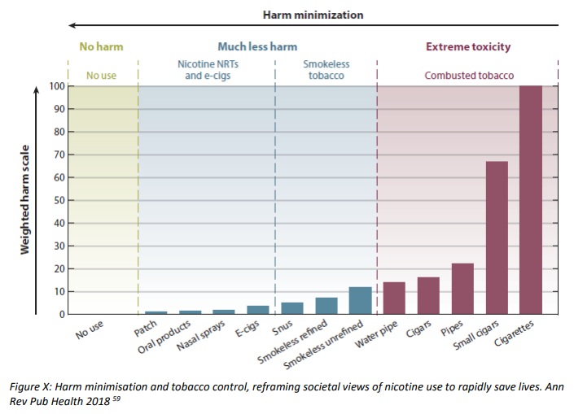
Consider the alternatives
Notes:
There are many less-harmful alternatives to smoked cigarettes – other ways of providing nicotine. They can also be part of a move away from any use of nicotine, but they can also be a very low-harm alternative to smoking as a way of getting nicotine over a longer period.
Swedish snus has been important in reducing smoking rates in Nordic countries. Its risks are trivial relative to smoking, and it provides a similar nicotine hit.
Many former smokers have found great success in vaping – work from Auckland University shows that vaping is far more effective than the patch alone; they didn’t test vaping alone against vaping-plus-the-patch, alas. But all signs point to its being a highly effective substitute for more harmful smoked tobacco, and especially where users can choose the flavours they find most appealing.
Heated tobacco products are far less harmful than smoked tobacco, but are likely to be a bit riskier than vaping. The numbers aren’t entirely settled on this one as best I can tell.

Slide 8
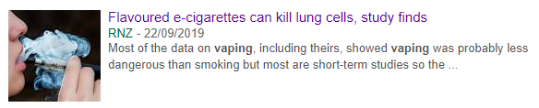
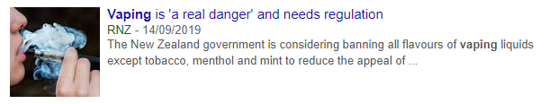


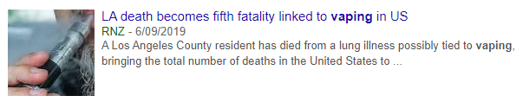
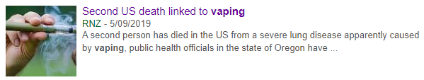

Moral panics and bad policy
Notes:
There is a substantial problem in the US right now: deaths and severe pulmonary illness. While it’s a developing story, it looks like about 90% of cases thus far involve the vaping of dodgy illicit THC cartridges. There’s a big industry of illicit vapes in the US, and cutting THC oil with Vitamin E acetate cuts costs for the illicit producers – while completely messing up peoples’ lungs. Radio New Zealand has been playing every one of these stories, sometimes just in the headlines but sometimes throughout the story, as being related to vaping but with no mention of that it’s vaping of dodgy illicit THC. You might as well run a scare campaign around the harms of alcohol based on problems abroad with bootleg whisky that had antifreeze in it.

Slide 9
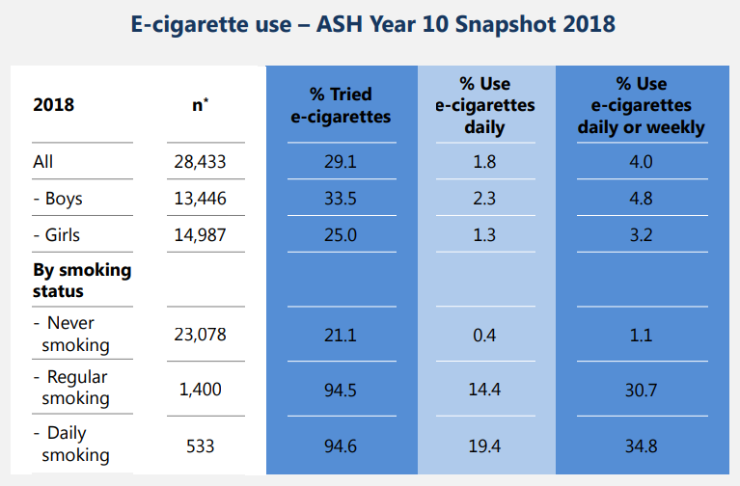
Moral panics and bad policy
Notes:
A third of students reported having tried an e-cigarette in 2018, even if only once. But no comparable increase in daily use. Very few who reported never smoking had ever tried an e-cigarette.
Public health folks will often cite the ‘about 30%’ figure – but those are folks who’ve tried, not kids who take it up regularly.

Slide 10
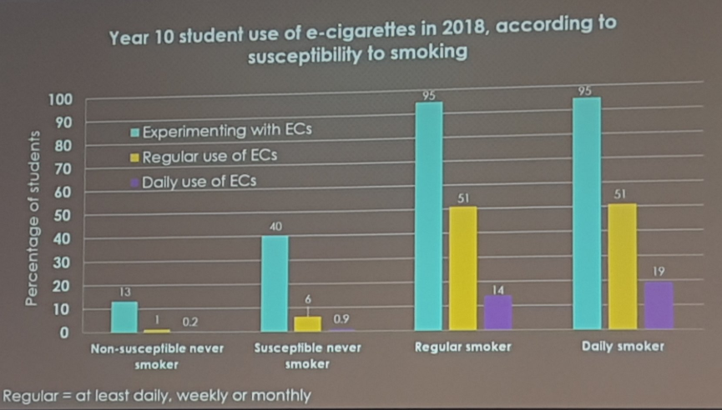
Moral panics and bad policy
Notes:
Source: ASH – from their e-cigarette forum earlier this year. Most EC youth users are kids who are smokers, or who were likely otherwise to be smokers.

Slide 11
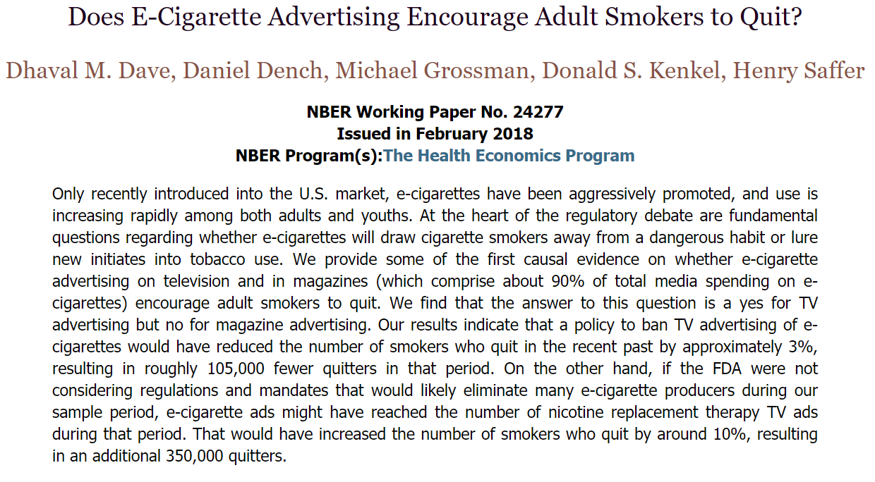
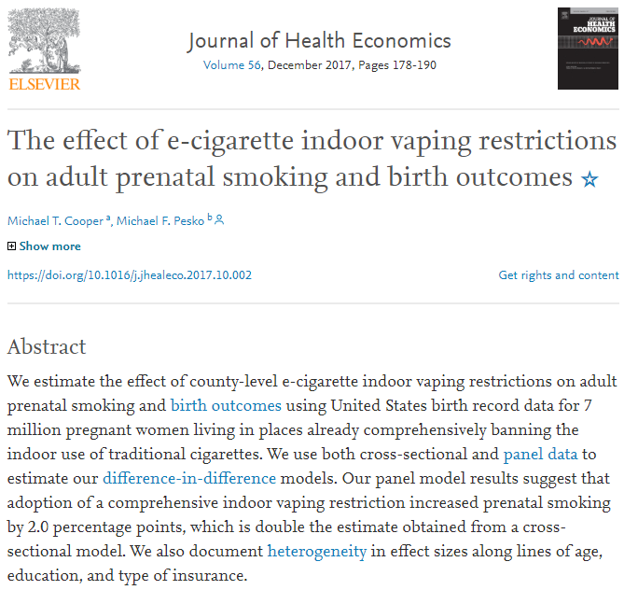
The untold story
Notes:
Dhaval Dave: banning tv advertising would reduce the number of smokers who quit by 3%; if FDA were not considering regs and mandates likely to eliminate many e-cigarette producers, e-cig ads would have increased to match nicotine therapy ads, increasing the number of smokers quitting by 10%.
Cooper & Pesko: indoor vaping restrictions increase prenatal smoking by 2 percentage points

Slide 12
Better policy, respecting choice, and reducing harm
Scale restrictions to risk;
Precautionary approaches are stupid given the counterfactual;
Be prepared to tweak regulation as science progresses
Notes:
Good policy in a world of alternatives
Lots of smokers are already choosing vaping on their own. They like it more than they liked smoking. Or, at least, they find that the experience is good enough when combined with the massive reduction in health risks. I wonder whether government and public health hostility to vaping is because vapers figured this one out on their own, without having been compelled to do it by the public health people.
What data is out there suggests that there’s no particular youth uptake of vaping. Some kids vape, and more will occasionally experiment with vaping, but they’re the kids who otherwise would have been smoking or experimenting with smoking. It is far better that their nicotine experimentation is with vaping than with tobacco.
Lots of vapers will testify to that different flavourings have been important in their switch from smoking to vaping. And that the ability to choose nicotine concentrations sufficiently high to mimic the hit that a cigarette provides matters too.
Vaping won’t work for everyone. So what we need is a policy environment that enables smokers to choose the option that works for them, and that provides appropriate information about the scale of risk.
Finally, the availability of substitutes for cigarettes makes demand for cigarettes more elastic – tobacco excise does not need to be as high to achieve the same level of demand reduction.
What does that mean for SmokeFree 2025? If I were designing the policy, there would be no bans of flavourings but there would be restrictions against marketing to children – in the same way that we already prohibit marketing alcohol to kids. There would be no other ban or restriction on advertising. Why? Because private companies advertising less harmful alternatives to smoking is an alternative to the government having to spend money on marketing campaigns making the same point about harm reduction. There’s very good US work showing that advertising bans, and especially television advertising bans, reduces the likelihood that smokers flip from smoking to vaping. Snus would be legalised immediately. And Radio New Zealand would go through some kind of purgatory for the stupid scaremongering that they’ve been broadcasting over the past couple months that paints US illness and death that has resulted from tainted cannabis-based vaping as something due to vaping more generally – RNZ is the worst. An excise-free period would apply through the government’s intended 2025 target. As the science develops, if it looks like heated tobacco products or other reduced-harm alternatives have sufficient health risk to warrant some kind of excise, we’d implement a lower-tier excise category for those products that makes them a bit more expensive than the least harmful alternative to smoking, but nowhere near as expensive as smoking. But don’t touch it until 2025. Put that in place and you’ll very likely reach the SmokeFree 2025 goal – but without having to have compelled anybody to do anything. Just make it easier for smokers to learn about and access the less harmful alternatives.

Slide 13
Smokefree 2025: Toward a better policy framework
Dr Eric Crampton
The New Zealand Initiative
Law & Economics Association New Zealand
24 September 2019

