Slide 1
We got it Wrong! Review of the RMA 1991 Economic Instruments
Presentation to LEANZ
February 9th 2021
Basil Sharp

Slide 2
Recognise & Acknowledge Institutional Failure
Regional council functions since 2005: allocation of fresh water, heat or energy from water, assimilative capacity of air & water, space in coastal marine area, ...
State of the environment is a product of governance:
Biodiversity, water and air quality, over allocation of fresh water, marine ecosystem, …
How has this come about?
Over allocated use: failure of governance at national/regional/local level
Setting initial entitlements: history of a race to the pump house, sequential allocation, over shoot
Unpriced resources: over use, rents accrue to consent holders
Poor monitoring & enforcement of resource utilization
Slow in setting standards & very limited use of economic tools
Deficient discipline in governance, lack of accountability

Slide 3
Purpose of NBEA
“… enhancing the quality of the environment to support the wellbeing of present and future generations.”
& achieving that purpose: promoting positive outcomes … use, development, protection only occurs within prescribed environmental limits …”
Outcomes to be supported by NPS, greater use of economic instruments, regulation & Strategic Planning Act.

Slide 4
Economic instruments
Principles are well known – nothing new, but little experience with application
Brief comments
Dealing with status quo outcomes & entitlements:
Requires innovation: over allocation? Transitioning to new regime?
Price discovery:
Auctions: rights to extract, reverse auctions rights
Environmental tax, bonds & royalties (administered prices) : (1) source of revenue; (2) may or may not achieve target; (3) unlikely to equal willingness to pay for the right/permit OR damages
Tradable rights: with scarcity, set target & allow market decide who enjoys right (right to use), quality of rights important
Coase – importance of transaction costs associated with trade

Slide 5
Quality of rights (permits, consents, …)
Transferability
1
Value of right
Shorter duration
Lower value
1
0
1
Certainty of title
Duration
1
Excludability

Slide 6
Rights to use & innovative technology
(1) Secure, quality rights
(2) Encourage efficient use of scarce resources: water, assimilative capacity, energy,…
(3) Innovative monitoring
We don’t face narrow specialised problems rather
complex ones that cut across sectors & disciplines

Slide 7
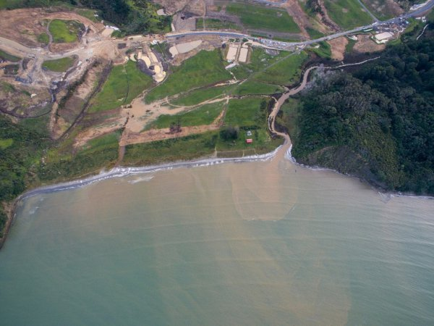
Regulatory environment
Urban development
Stream protection

Slide 8
Towards a new governance structure
Partnerships with local iwi – Te Tiriti o Waitangi
Targets, learning, adaptation
Mandatory, transparent targets, measured, monitored
Audit performance against targets – PCE & report to parliament?
Dynamic Adaptive Governance
Are economic/regulatory instruments delivering the targets? Least cost?
Adapt instruments against performance
Full cost recovery – permits/rights not subsidized by general rate levy
Challenges
Dealing with existing entitlements
Cultures of innovation – dealing with complex challenges, cross discipline, Te Tiriti o Waitangi, unleash technology
Capacity building – skills to support decision making

