Slide 1
New Zealand Space Agency
LEANZ Wellington Seminar - 11 December 2020
^{NEW SPACE NEW ZEALAND}
^{Te Manatū Tuarangi o Aotearoa}

Slide 2
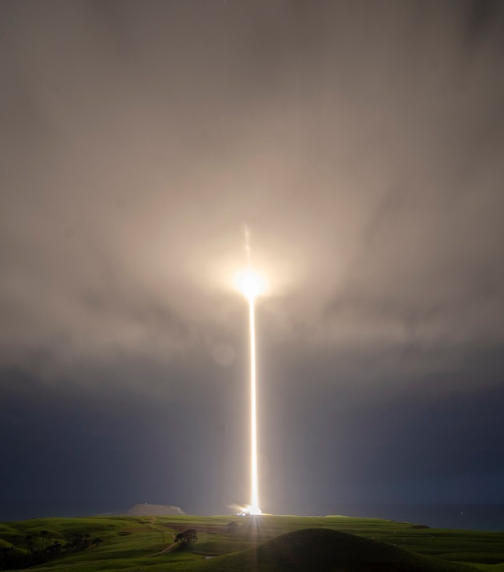
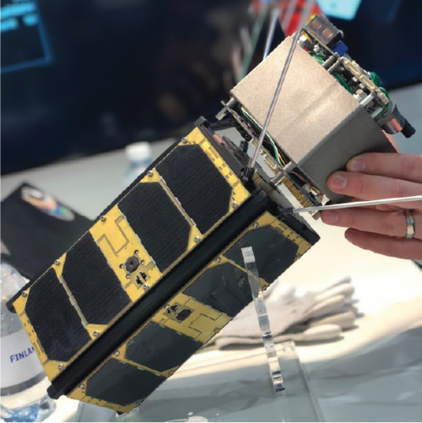
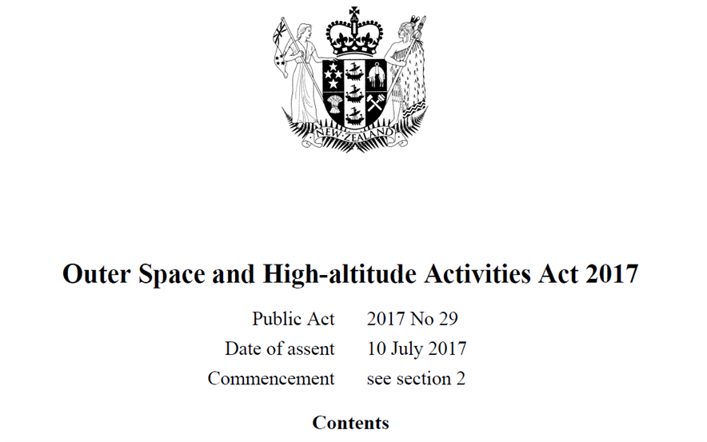
New Zealand’s Journey to Space
Where are we now?
Electron launches from the Mahia Peninsula
Credit: Sam Toms, Rocket Lab
An example of New Space: Dawn Aerospace’s “off-the-shelf” propulsion technology being integrated with a CubeSat
Credit: Dawn Aerospace
New Zealand’s Space Regime: The Outer Space and High-altitude Activities Act (OSHAA)

Slide 3

The International Environment
Our obligations and values
New Zealand is party to a number of international treaties on space:
Outer Space Treaty
Registration Convention
Liability Convention
Rescue and Return of Astronauts Agreement
…and adheres to a number of other guidelines and standards, such as:
The UN COPUOS Long-Term Sustainability Guidelines
Orbital Debris Mitigation best practices

Slide 4
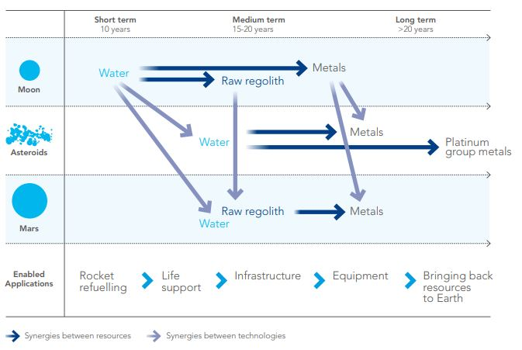

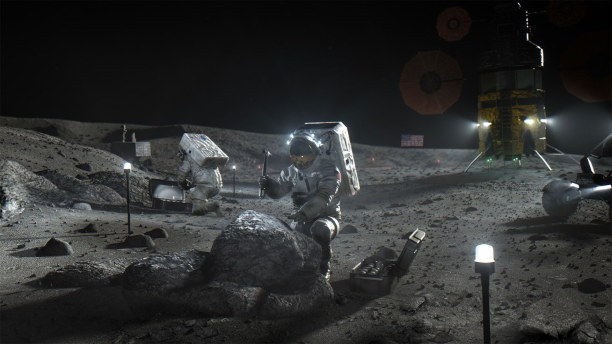
Space Resource Utilisation
Enabling the frontier of human exploration
SRU activities and timelines
Credit: Luxembourg Space Agency
NASA’s Artemis Programme and Accords
Credit: NASA

Slide 5
Key Questions
Where to from here?
How do we enable private actors to undertake these activities at the highest value/lowest cost to society?
What are the right incentives and how do we put these in place?
How do we reconcile the provisions of the Outer Space Treaty with property rights?

Slide 6
^{NEW SPACE NEW ZEALAND}
^{Te Manatū Tuarangi o Aotearoa}
Contact us
New Zealand Space Agency, 15 Stout Street, PO Box 1473,
Wellington 6140, New Zealand. nzspaceagency@mbie.govt.nz | +64 4 952 1663

