Slide 1


The transition to a low-emissions economy
Murray Sherwin
LEANZ Seminar
Wellington, 28 March 2019

Slide 2
Inquiry into New Zealand’s transition to a low-emissions economy
How New Zealand can reduce its domestic greenhouse gas emissions through a transition to a low-emissions economy, while at the same time continuing to grow incomes and wellbeing.

Slide 3
The inquiry process
Published an issues paper in August 2017, a draft report in April 2018 & the final report in August 2018
Received and analysed 403 submissions
Attended numerous industry & other conferences and events
Two-phased modelling of the transition, including a focus on uncertainty
The inquiry process
Research note on the UK Climate Change Act
Commissioned expert advice on the future of the electricity sector
120+ engagement
meetings

Slide 4
NZ’s challenge to get to net-zero emissions
Transport
Electricity generation
Industrial heat
Other
Notes:
The terms of reference detailing the scope of the investigation were issued by the previous government.
The new Government directed the Commission to continue the inquiry, but asked that we consider a net zero 2050 target.

Slide 5
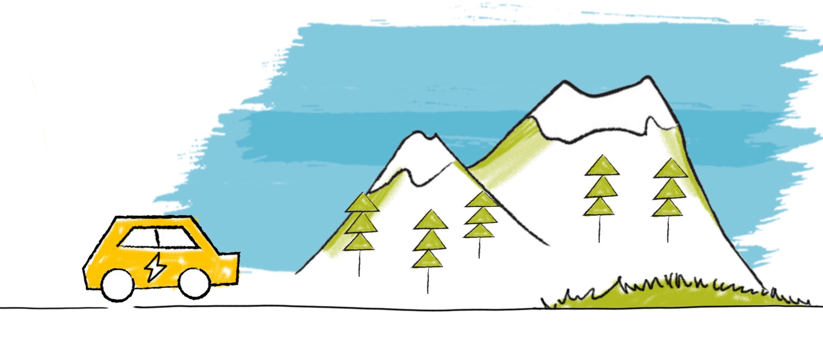
Key changes needed
1. Replace fossil fuels with electricity and other low-emissions fuels
2. Significant afforestation
3. Changes to the structure and methods of agricultural production
Notes:
Modelling showed that three key changes must occur if New Zealand is to achieve its low-emissions goals:
A transition from fossil fuels to electricity and other low-emissions fuels across the economy. This means a rapid and comprehensive switch of the light vehicle fleet to electric vehicles (EVs) and other very low-emissions vehicles, and a switch away from fossil fuels in providing process heat for industry, particularly for low- and medium-temperature heat users.
Substantial levels of afforestation to offset New Zealand’s remaining emissions. This will require sustained rates of planting over the next 30 years (mostly on land currently used for sheep and beef farming) potentially at an annual rate approaching the highest ever recorded (100 000 hectares in 1994). Overall, an additional 1.3 to 2.8 million hectares of forest will be needed, likely a mix of exotics and natives. Importantly, new forests only buy time. In the longer term, new approaches to bring net emissions to zero will be required. It is critical that emissions reductions in other parts of the economy continue alongside afforestation.
Changes to the structure and methods of agricultural production. This will include diversification of land use towards horticulture and cropping, and greater adoption of low-emissions practices on farms.

Slide 6
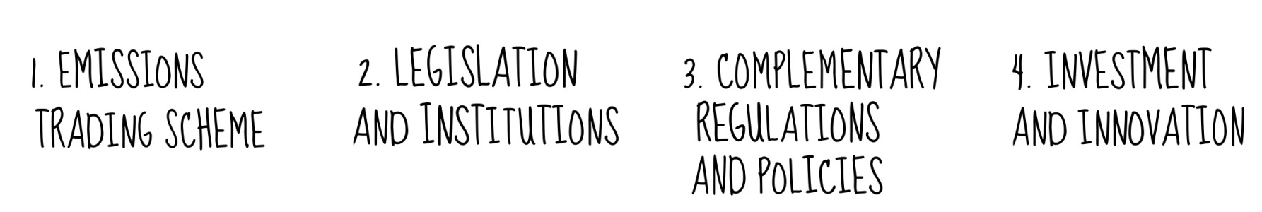
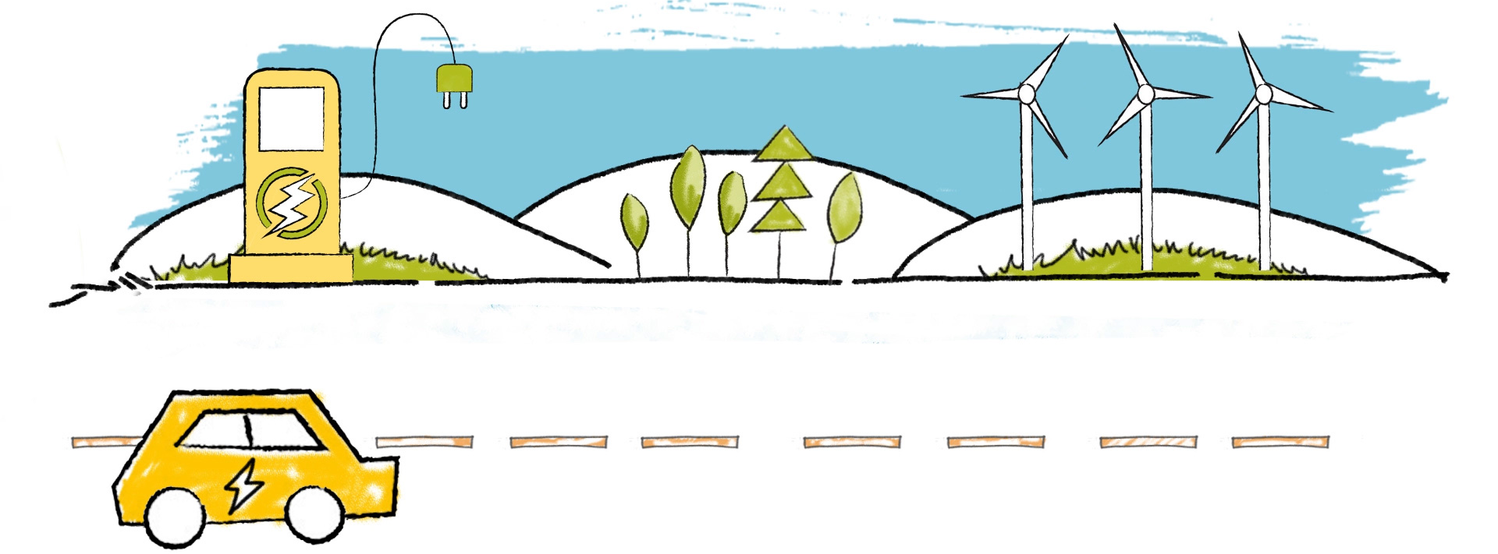
Four pillars to achieve a low-emissions economy

Slide 7
Emissions pricing
Effective emissions pricing provides a strong incentive to reduce emissions at least cost
But the New Zealand ETS needs reform to be effective:
Higher emissions prices
Increased coverage across the economy (including N₂O from agriculture)
Greater clarity about the future supply of emission permits
Price biogenic CH₄ (either in a dual-cap NZ ETS or a CH₄ quota system)
Notes:
New Zealand has had an emissions trading scheme since 2008, however design issues have limited its effectiveness.
Robust and transparent domestic caps on the supply of New Zealand Units are needed to drive a higher emissions price to materially influence production and consumption decisions.
Expectations about future emissions prices are important for driving investment in new technologies. To ensure clear and credible investment signals, the Government needs to set a clear, long-term emissions target and use emissions budgets as stepping stones to the target.

Slide 8
Modelling: 3 scenarios and 2 targets
Modelling examined 3 pathways that lower emissions to 2 targets
Policy driven: assumes that technologies are slow to develop and reductions in emissions must rely on strong policy such as high emissions prices
Disruptive: assumes that technological change is fast, and it disrupts existing industries
Stabilising: assumes that technological change is also fast, but it reduces emissions in existing industries
 | Scenario | Emissions target in 2050 | Pathway name
1 | Policy Driven Decarbonisation | 25 Mt CO₂e | PD – 25
2 | Policy Driven Decarbonisation | Net zero | PD – 0
3 | Disruptive Decarbonisation | 25 Mt CO₂e | DD – 25
4 | Disruptive Decarbonisation | Net zero | DD – 0
5 | Stabilising Decarbonisation | 25 Mt CO₂e | SD – 25
6 | Stabilising Decarbonisation | Net zero | SD – 0

Slide 9

Let an effective emissions price do its work
Notes:
Chart depicts the evolution of the emissions price under different assumptions modelled for the Commission by a consortium of Vivid Economics, Concept Consulting and Motu.
The results suggest emissions prices rising from the current $24/tonne to at least $75/tonne and possibly over $200/tonne as we approach 2050.
These prices are comparable to what are likely to be necessary in the rest of the developed world to limit global warming to under 2˚ C, consistent with the Paris Agreement (as estimated by the Carbon Pricing Leadership Coalition under the auspices of the IEA)

Slide 10

Short- and long-lived gases
Total amount of GHGs consistent with 2˚C warming
Outflow of short-lived gases
Inflow of short-lived gases
Stock of short-lived gases
Inflow of long-lived gases
Stock of long-lived gases
The long-lived gas steady state requires that inflows are net-zero.
The short-lived gas steady state requires inflow = outflow.
Notes:
Long-lived gases (ie, CO₂ and Nitrous Oxide) persist in the atmosphere for hundreds of years, so the warming from a pulse of a long-lived gas is effectively irreversible. On the other hand, short-lived gases (ie, methane) dissipate from the atmosphere after a few decades.
For long-lived gases, reaching net zero emissions is the only way to halt the rise in the atmospheric stock.
For short-lived gases, the story is different. To reach the same goal, that is, to halt the rise in the stock, the first aim is to prevent increases in the flow of emissions. With a life of under 20 years, a flat to declining flow of emissions of methane is consistent with a flat to declining stock. There is a case for going beyond that to seek a reduction in the flow (and therefore the stock) over time. Research released just after the completion of our report suggests that methane will need to stabilise at around 20% below the current level in order to prevent further warming. But to halt an increase in the warming influence from short-lived gases we do not have to target net zero emissions.

Slide 11
Complementary regulation and policies
Transport
Electricity
Industrial heat and processes
Notes:
Emissions pricing, stable policy, and a well resourced innovation system are all needed to change behaviour and promote investment.
But, on their own, they will not be enough to maximise the opportunities of the transition for all New Zealanders. A range complementary policy and recommendation will be required.
The Commission’s final report provides recommendations to support emissions reduction across each of New Zealand’s main emissions sources.
The remaining sections of this presentation focus on three areas of particular importance to large energy users: transport, electricity and heat and industrial processes.

Slide 12



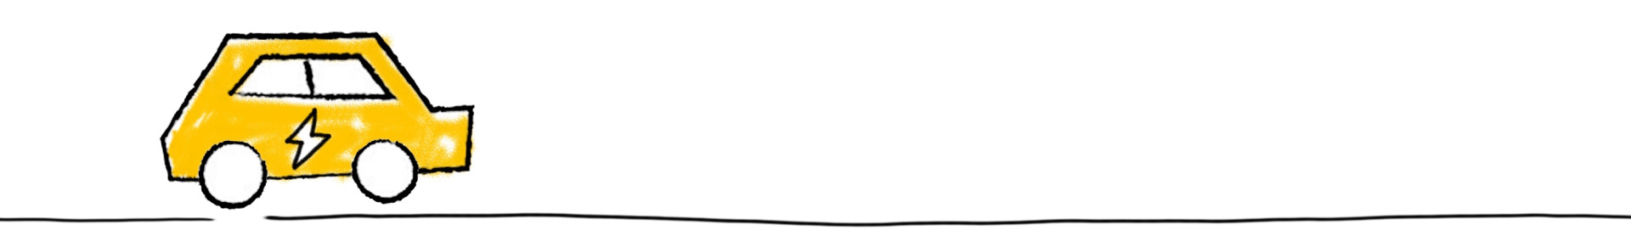
Light transport
Electric vehicles (EVs) are the most significant opportunity to reduce transport emissions. Because of the slow turnover of the vehicle fleet in New Zealand, fast early uptake is necessary.
Feebate scheme to encourage consumers to purchase lower-emitting vehicles.
Emissions standards for vehicles entering the fleet.
Active pricing of other vehicle externalities (eg, congestion and air pollution).
Notes:
The Commissions modelling suggests that to meet net zero in 2050, EVs will need to comprise a significant share of the light vehicle fleet (ranging from 40% to 80%).
To electrify the bulk of the light vehicle fleet by 2050, nearly all newly registered vehicles (including used imports) would need to be electric by the early 2030s.
The importance of early uptake reflects the long period that vehicles stay in the fleet. Because of the lock-in effect of high-emitting vehicles, the earlier that EV uptake accelerates, the lower New Zealand’s total emissions will be over the next few decades.

Slide 13
Heavy transport
More challenging to reduce emissions
Government should remain technology neutral, as the most effective solutions are not yet clear
Low-carbon fuel standards or a grant scheme for low-carbon fuels are options to support biofuels and other low-emission fuels for New Zealand’s heavy transport fleet
Notes:
Decarbonising freight and heavy transport is more challenging than for light vehicles. For some light freight tasks electrification is likely to be viable. However, large reductions for heavy and long-distance freight will rely on further advances in technology including better battery technology, hydrogen or drop-in biofuels.
The most effective solution is not yet clear, and may involve a mix of fuel sources. The Government should pursue a mix of policies that provides evenhanded support for these technologies. Two options are a low-carbon fuel standard and a grant scheme for low-carbon fuels.
Low-carbon fuel standards would set limit on the carbon intensity – the amount of GHGs emitted per megajoule of energy produced – of fuels across the vehicle market. The limit falls gradually each year. This relies on sufficient access to alternative fuels at a reasonable cost.
Under a grant scheme fuel producers could receive a grant based on the amount of fuel they produce, based on the carbon intensity of the fuel. The approach requires comprehensive data on the full life-cycle emissions from the production of fuels.

Slide 14


An abundant supply of low-emissions electricity
Low-emissions (and low price) electricity is central to the transition
New Zealand has abundant unused sources of renewable energy (especially wind but also solar)
Targets for emissions reductions need to be met without driving up wholesale prices
Resource consents under the RMA must be compatible with increased renewable generation
Demand-side management (eg, time-of-use pricing) and distributed energy (eg, solar power and batteries) will play an increasingly important role
Notes:
New Zealand already has a relatively low-emissions electricity system. However, electricity generation will likely need to increase by at least 50% by 2050 (Transpower estimates closer to 100%).
An abundant supply of low-cost, low-emissions electricity will be important as other parts of the economy switch from fossil fuels to electricity.
Under current technology and prices, no options exist to completely eliminate greenhouse gas emissions from electricity generation, without greatly increasing wholesale electricity prices. Yet technology is changing rapidly and by 2050 economic options, such as tidal or biomass generation, or excess wind generation, or carbon capture and storage, may have emerged. The Government should rely on an effective emissions-pricing system as the main instrument to achieve an efficient trade-off between emissions reductions in electricity and emissions reductions in other parts of the economy. The Government should be cautious in specifying targets for emissions within the electricity sector, and make sure that technology is available to meet them without significantly increasing wholesale electricity prices above the levels achieved with current technology.
Regulatory reform to facilitate the expansion of both grid-scale and distributed renewable energy generation is needed alongside the removal of barriers to innovative technologies that assist consumers to manage their demand during peaks.

Slide 15

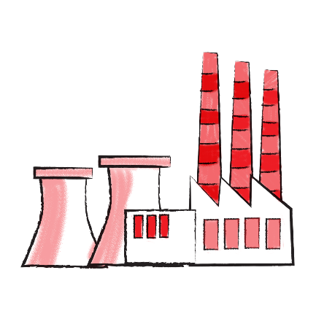

Heat and industrial processes
Energy and process efficiency improvements can materially reduce emissions
But in the next two decades, large energy users should prepare to switch away from fossil fuels for process heat
The viability of low-emission fuels varies depending on factors such as geographic location and the nature of heat required
Electricity and biomass appear the most promising options
Fuel switching likely to occur gradually as assets are retired
Notes:
Around 9% of New Zealand’s GHG emissions result from combustion of fossil fuels in manufacturing – mostly to produce process heat. These emissions have grown 25% since 1990. Industrial processes (the transformation of one substance into another, such as iron sands into iron), account for about 6% of total emissions, and have been flat over the past two decades.
For many heat users, potential exists to materially reduce emissions through measures to reduce the energy requirements associated with a process, such as energy and process efficiency improvements.
More substantive emissions reductions will require conversion to lower-emission fuels.
The technical and commercial viability of low-emission fuels varies on a case-by-case basis depending on factors such as geographic location and the nature of heat required. Electricity and biomass appear to be the two options with widest applicability.
Electrification can be a cost-effective mitigation option for low-temperature heat requirements at current prices, provided that it is applied using heat pumps and other technology with coefficient of performance well above 1.
Sustainably sourced biomass is already widely used to generate process heat. Concerns about supply are one barrier to uptake, but this is likely to change if emissions prices climb and rapid afforestation occurs.
Given the long lives and high costs of boilers and other heat plant, decarbonisation of industrial heat processes is likely to occur gradually as these capital assets reach the end of their useful lives.

Slide 16
Heat and industrial processes
Emissions prices to drive a switch to low-emissions fuels
Government can take the lead in transitioning away from coal and other fossil fuels to heat publicly owned buildings
Barring technological breakthroughs, mitigation opportunities for process emissions from iron & steel, cement and aluminium production are limited
Notes:
We see emissions pricing as the main policy to drive the adoption of lower-emissions fuels.
But Government can also play a role – for example we recommend that Government should take the lead in transitioning away from coal and other fossil fuels by limiting the installation of new fossil-fuel powered plant for low-temperature heat in publicly owned buildings. We also see an ongoing role for EECA in addressing any information and coordination barriers that are hindering the uptake of biomass and other low-emission fuels for heat.
We found few mitigation opportunities for process emissions (for example in the production of cement, aluminium and steel), however some promising developments overseas may change this over the next two decades.

Slide 17

Concluding remarks
The low-emissions transition will be challenging but achievable
Acting early avoids high emissions lock-in – delaying action makes the transition costlier and more abrupt

Slide 18


