Slide 1
The COVID and the Damage Done
Law & Economics New Zealand Panel Discussion
Limiting COVID’s Economic Fallout
27 May, 2020
Dr Eric Crampton
Chief Economist
The New Zealand Initiative

Slide 2
A brief overview and summary
Scaling up public health capabilities allows more economic activity;
Opening the border can be done safely and is critically important;
Maintaining fiscal prudence and strong microeconomic foundations matters.

Slide 3
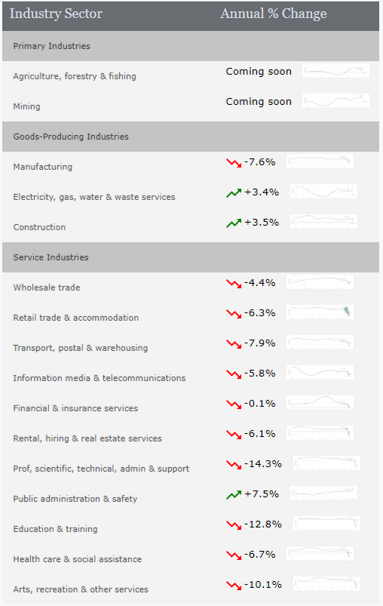
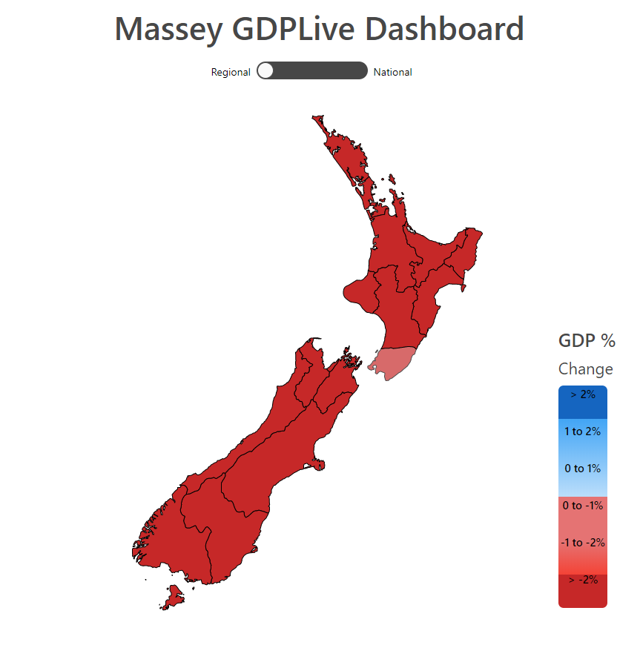
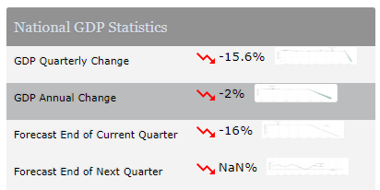
The COVID and the Damage Done

Slide 4
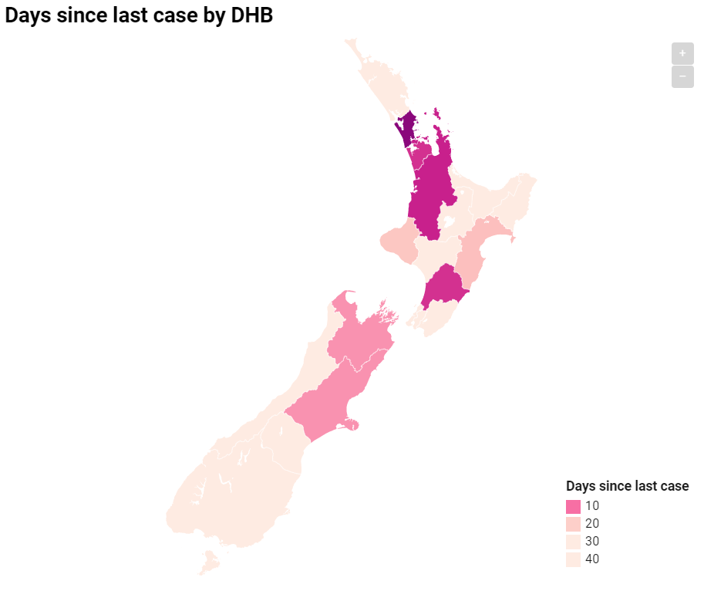
Region by Region
As of 15 May, it had been at least 28 days since the last case of COVID-19 in each of:
Southern DHB
South Canterbury DHB
West Coast DHB
Hutt DHB
Wairarapa DHB
Lakes DHB
Tairawhiti DHB
Northland DHB
Twelve days later, three new cases have principally been part of Auckland clusters.
14 DHBs have ZERO active cases.
Why is Southland not at Level 1?

Slide 5
Caution comes in many forms
Avoiding the need for any future lockdowns is critically important;
Continued operation at Level 2 and closed borders is one way, but an expensive one;
Scaled up contact tracing is another – and a better one.
Notes:
Bloomfield says they will be able to trace all people at events of up to 100 people within 2 days of a case being confirmed.
We keep hearing nervousness about contact tracing being part of the reason for tight controls.
Scale up and build a reserve army of contact tracers!

Slide 6

Hong Kong Arrivals
Residents returning to Hong Kong are tested on arrival, then quarantined.

Slide 7
The COVID and the Opportunities Forgone
In every other sector, the best we can hope for is limiting the damage.
What opportunities would a better border bring?
  International export education: 1.1% of GDP and strong growth potential
  International sporting codes
  Film and more!

Slide 8
Fiscal prudence and microeconomic sensibility
Taking on debt to deal with a crisis makes sense;
Doing so well requires fiscal prudence;
Paying it back requires not breaking everything else! Overseas investment, forestry….

