Slide 1
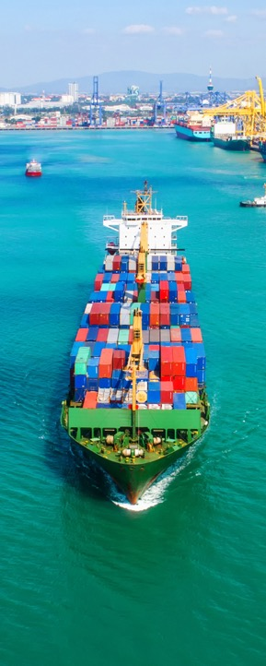
The Future
of Global Trade Institutions
Stephen Jacobi and
Stephanie Honey
New Zealand
International Business Forum
Law and Economics Association of New Zealand
Wellington
29 April 2021

Slide 2
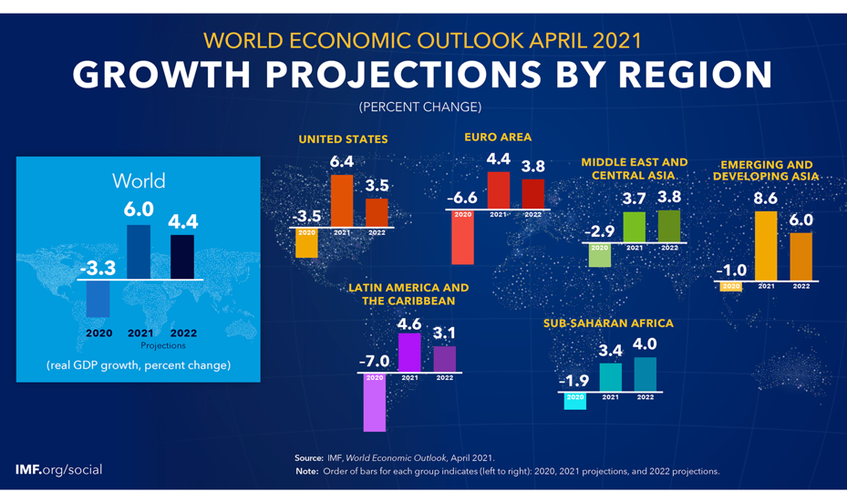
Source: IMF World Economic Outlook, April 2021

Slide 3
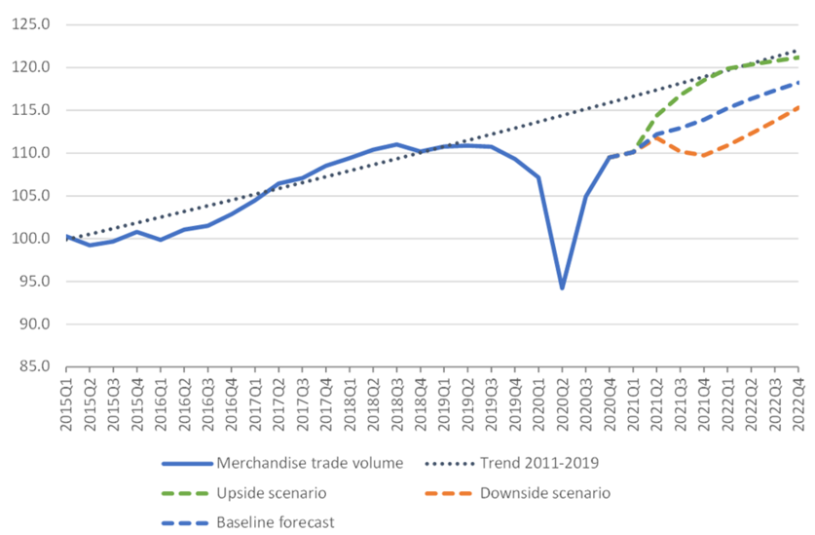
Global trade: what is the new normal?
Source: WTO Secretariat, April 2021

Slide 4
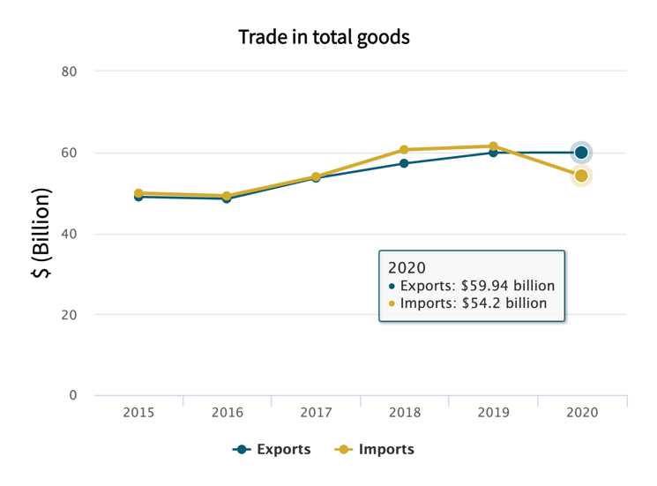
NZ goods trade has held up well …
Source: StatsNZ Trade Dashboard

Slide 5
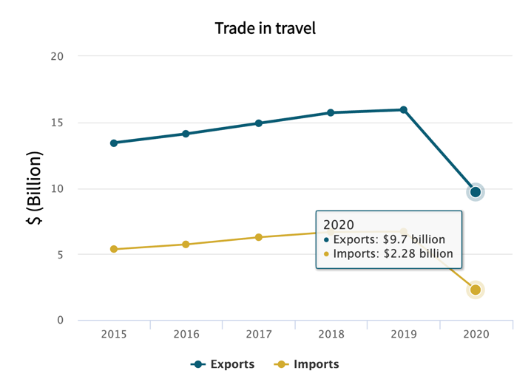
…services exports, less so
Source: StatsNZ Trade Dashboard

Slide 6
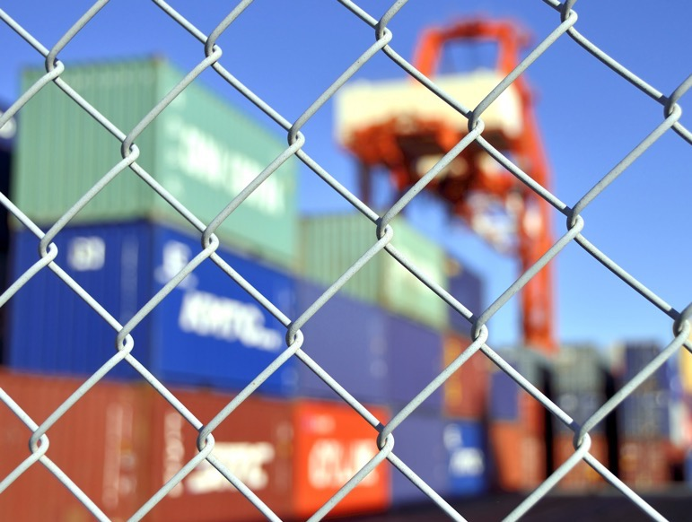

Slide 7
Source: GlobalTradeAlert.org

Slide 8
Trade is critical for vaccines
Source: OECD, Using Trade to Fight COVID-19: Manufacturing and Distributing Vaccines, 11 February 2021

Slide 12
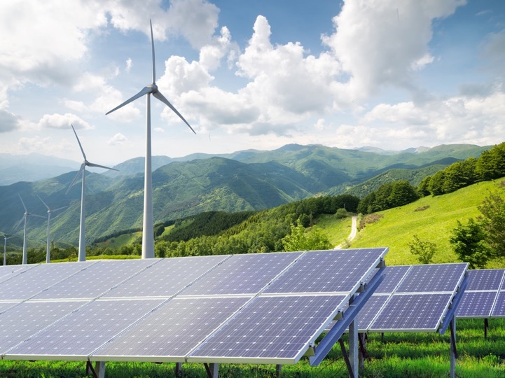

Slide 14
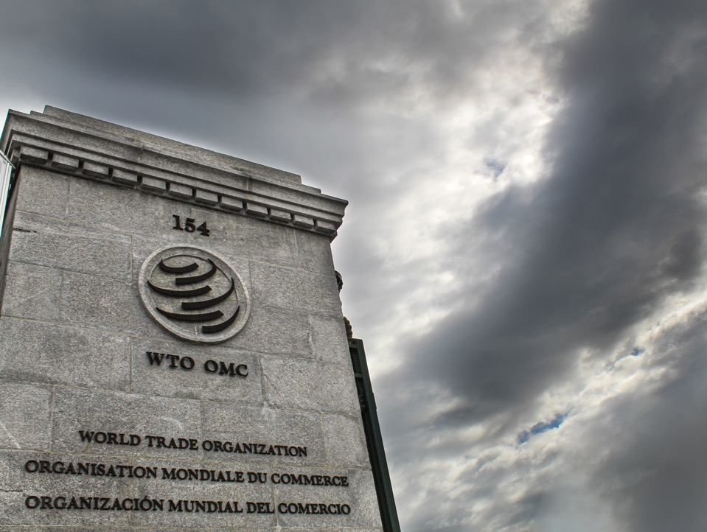
Troubling times for the WTO

Slide 15
WTO functions
Global set of trade rules
Neutral arbiter for disputes
Negotiating forum

Slide 17
Dispute settlement….

Slide 18
Renovating the architecture…

Slide 19
What’s in the mix?
Investment Facilitation
(98 members)
Services Domestic Regulation
(60 members)
JSI
JSI
E-commerce
(88 members)
Agriculture
Fish subsidies
Rules (subsidies, AD, DSU)
Other issues (services, industrial goods, IP, environment)
Informal working group
DOHA
MSMEs
(91 members)
Env Goods & Services
Fossil Fuel subsidies
JSI
Women
(127 members)
Subsidies
(US, EU, Japan)
Developing country S&DT
(US + others)
Transparency
Informal working group

Slide 20
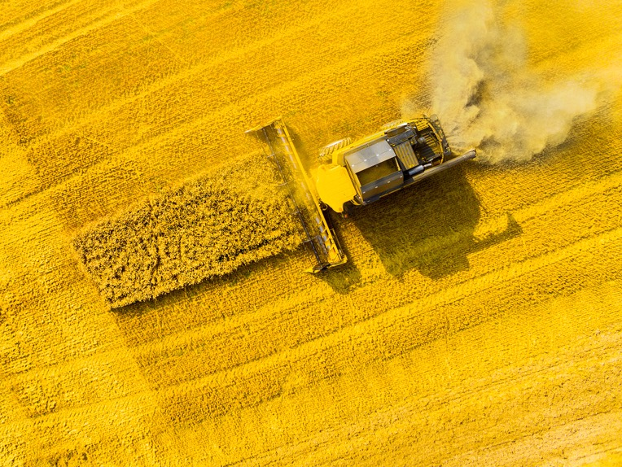
Agriculture…
$708 billion
total agriculture support per year
Source: OECD

Slide 21
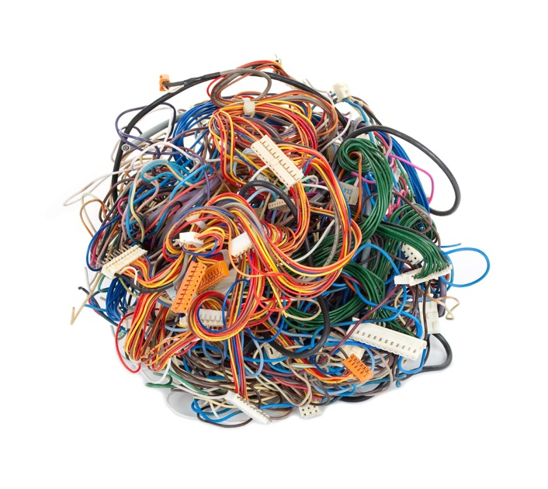
E-Commerce…

Slide 22
Services…
Year-on-year growth in commercial services trade, 2020
Source: WTO, February 2021

Slide 23
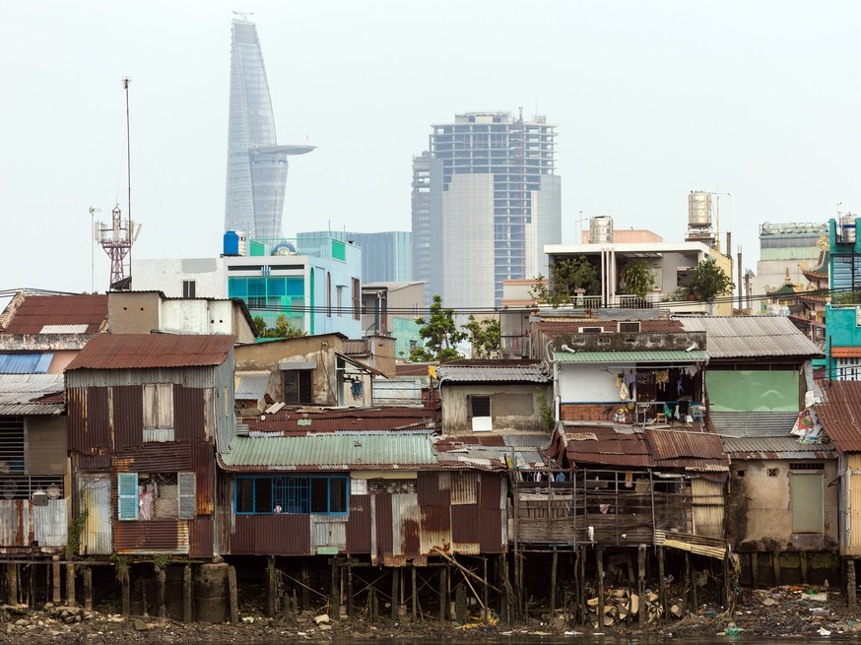
Inclusion

Slide 24
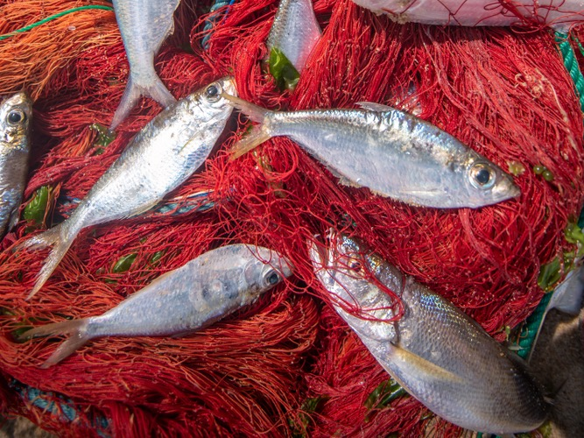
Fish subsidies

Slide 25
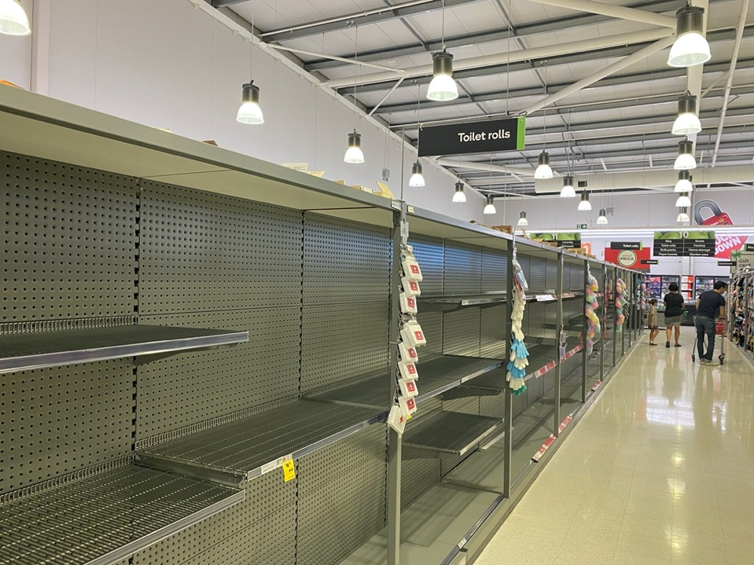
“Pandemic trade policy”

Slide 26
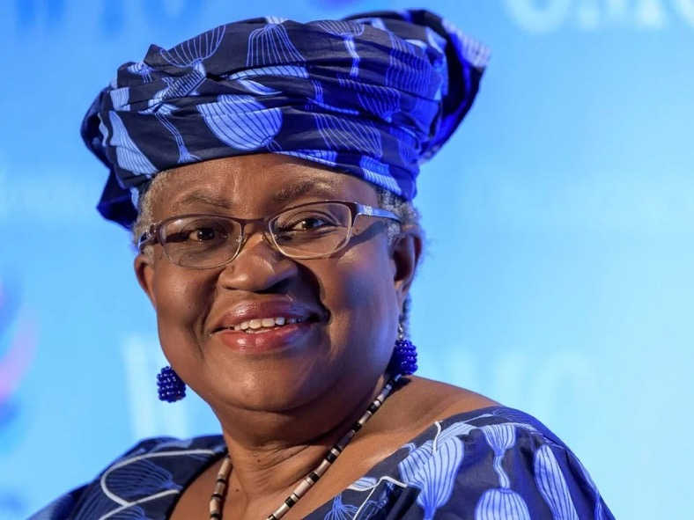
New DG Big To-Do List

Slide 27
Thank you!
@TradeWorksNZ

