Slide 1

Challenges facing the electricity sector
Presentation to LEANZ
Carl Hansen, Capital Strategic Advisors Limited
24 June 2021
Notes:
Thanks to LEANZ for inviting me to return to an area of economics that I’ve found interesting and enjoyable for a couple of decades, and which I’ve missed since leaving the EA.
In my view arrangements for electricity security of supply have come a long way since the early 1990s
And I reckon the sector is reasonably well placed to meet the challenges coming its way but urgent work is needed to further improve its chances of succeeding.

Slide 2
Overview
Background: pre 1996
Past challenges: 1996 – 2017
  Security of supply
  Competitive pricing and behaviour
Recent challenges: 2018 – now
  Security of supply (again)
  Competitive pricing and behaviour (again)
Forthcoming challenges
  Carbon emissions policy
  Technology change and innovation
Notes:
Two books that have framed my public policy thinking for many years are Avinash Dixit’s 1996 monograph entitled The Making of Economic Policy, which applies transaction cost theory to politics and policy making, and John Kay’s book called Obliquity.
Dixit’s book provides a clear-headed economic analysis of policy-making that takes into account the knowledge, incentives and decision rights within government and with private sector stakeholders.
Obliquity is an easier and enjoyable read, and is also about the importance of addressing economic problems indirectly, through round-about methods.
In other words, focus on knowledge, incentives and decision rights, and you will see that I think it particularly useful to frame security of supply policy along those lines.

Slide 3
Since leaving the Electricity Authority in mid 2018, I have provided strategy and policy advice on matters relating to this presentation to:
A member of the distribution sector
A major generator-retailer
An industrial consumer
Government agencies
Disclosure
Notes:
Before I elaborate on those themes, let me disclose that I’ve undertaken assignments from across the electricity sector in the last three years. I still see myself as a pro-consumer guy, and so its on that basis that I’ve accepted assignments with the kinds of entities listed on the slide.
And its on that basis that I’m currently assisting the Infrastructure Commission, covering a wide range of infrastructure sectors on matters relating to technology advances, climate change policies and population growth and decline. The views I’m expressing tonight are mine and have not been discussed with the Commission.

Slide 4
Overview
Background: pre 1996
Past challenges: 2001 – 2017
  Security of supply
  Competitive pricing and behaviour
Recent challenges: 2018 – now
  Security of supply (again)
  Competitive pricing and behaviour (again)
Forthcoming challenges
  Technology change and innovation
  Carbon emissions policy
Comparative assessment
Notes:
By way of background:
The spot electricity market began on 1 October 1996, providing price discovery at 244 nodes across the national grid.
A voluntary hedge market was also provided for in the 1996 design, however it attracted little activity and little serious policy attention for many years.
When I came into the EA my view was that further developing the hedge market should be top priority, and I still think further enhancements are essential.
As many of you will know, the spot market originated from severe security of supply (SOS) problems in 1992, and in fact severe shortages occurred several times before that, with two events in the mid and late 1980s despite the country having generation potential during normal hydrological conditions far exceeding efficient levels … see the red dots on the next slide

Slide 5
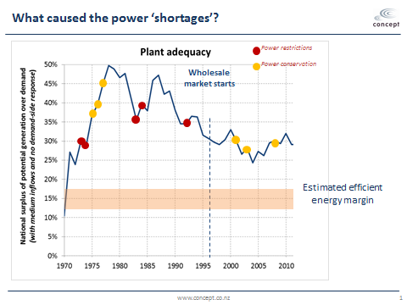
The ‘good ole’ days before the spot market began were not flash for security of supply
Notes:
To cast your mind back to the period before 1992, we had a single provider building and operating almost all of NZ’s generation.
During the corporatisation era in the late 1980s, the Electricity Corporation of New Zealand (ECNZ) was established and ran the whole show, owning and operating 97% of NZ’s generation capacity.
You can see however, despite substantial generation potential – far exceeding the estimated efficient margin over demand – NZ had numerous mandatory power restrictions (red dots) before spot market began.
There haven’t been any power restrictions since the spot market began, although during the 2000’s there were three power conservation campaigns, where consumers were asked to save power.
And since 2010, we haven’t had any conservation campaigns.

Slide 6
Comparative assessment of security of supply arrangements
 | Knowledge | Incentives | Decision rights
Pre 1996: Centralised phase |  |  | 
1996 – 2003: Market phase I |  |  | 
2003 – 2010: Market phase II |  |  | 
2010 – 2020: Market phase III |  |  | 
Notes:
The SOS outcomes from the centralised phase involved many instances of rolling blackouts and conservation campaigns.
Centralised structure placed all operational decision-making for generation in the hands of a single player. Hence, poor allocation of decision rights.
Lack of market pricing left consumers with poor information and no incentives to conserve demand when supply risks increase.
The single generator also had poor knowledge of the costs to industrial consumers (and other consumers) of supply shortages.
The single generator faced political incentives to avoid an unnecessary SOS event but not financial incentives to do so.
It also faced political incentives to keep electricity costs low, which it did by closing a significant thermal plant in the early stages of the 1992 dry episode.
Market phase I was an improvement on the centralised approach, but without a well-functioning hedge market it created an unintended cycle of political hedging rather than financial hedging.
We can see from the previous chart that the competitive spot market approach achieved better physical outcomes – no rolling blackouts.
But as I will now show, it greatly exacerbated commercial risks for unhedged industrial consumers and retailers.

Slide 7
Overview
Background: pre 1996
Past challenges: 1996 – 2017
  Security of supply
  Competitive pricing and behaviour
Recent challenges: 2018 – now
  Security of supply (again)
  Competitive pricing and behaviour (again)
Forthcoming challenges
  Technology change and innovation
  Carbon emissions policy
Comparative assessment
Notes:
When the spot market started in 1996, we had only two large generators competing in the market: Contact Energy with about 25% of the old ECNZ generation capacity and new ECNZ with the remaining 75%.
The buy-side was typically 1 or 2 buyers, with generation vertically separate from retailing.
And spot prices averaged just $35 per MWh over 96 – 2001, a level that now looks exceedingly low, and in fact they were unsustainably low.
Structural reforms in 1998/9 increased the number of large generators from 2 to 5, with ECNZ split into Mercury, Genesis and Meridian and the fifth largest generator coming from the forced separation of distribution and retailing activities, which led to the creation of Trustpower. Todd Energy was the 6th large competitor.
More importantly, the forced separation of distribution and retailing activities led to the four large generators buying the retailing activities off distribution businesses, which meant the generators had far less need to hedge their spot market risks, and this basically killed off the hedge market.

Slide 8
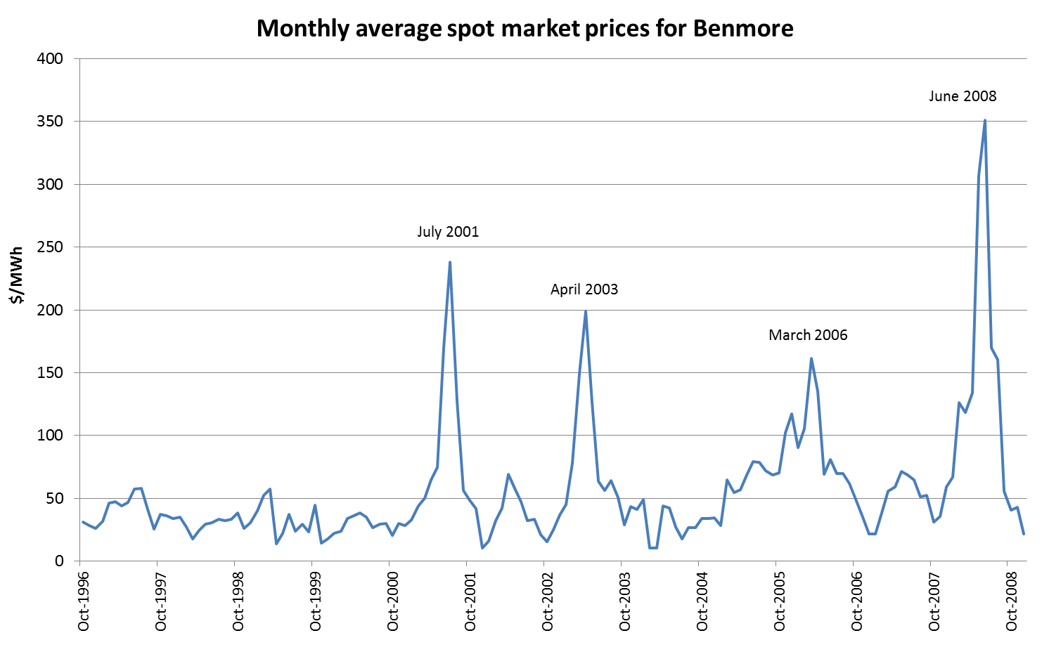
Four SOS events, each with huge price effects
Notes:
This chart of monthly average spot prices shows that benign hydro conditions over the 1996 – 2000 period masked the extent of commercial risks, which wasn’t good for encouraging industrial consumers to hedge their spot market risks.
As a result, many industrial consumers – and NZ’s largest electricity retailer – were largely unhedged when the first dry event occurred in mid 2001, and for various reasons I can elaborate on later, many remained unhedged when the 2003 event occurred.

Slide 9
The market avoided blackouts but it created incentives for unhedged buyers to claim uncompetitive pricing – sound familiar?
The sky-high spot prices created strong commercial incentives on retailers and large consumers to create a sense of crisis and seek “political hedges”
  Spot market buyers sought “political hedges” due to lack of financial hedging against the risk of high spot prices
However, the problem diagnosis in late 2003 was that the market won’t build enough generation to cover dry year risks.
  Government introduced a reserve energy scheme in 2003
  It paid Contact Energy to build the Whirinaki diesel power station to provide reserve energy
  Capex covered by a levy, undermining private investment in peaking and dry year plant
  Government committed to only operating when p > fuel costs
  But diesel prices role to > $400 in 2008 & so Whirinaki operated when spot prices < fuel costs!
Notes:
Regime change: the Government replaced the Electricity Commission with the Electricity Authority
The EA was given a clear set of objectives, functions and powers.
Objectives – promote competition, reliability/security of supply and efficiency for the long-term benefit of consumers
Functions – right the rules, undertake market facilitation measures, undertake active monitoring of market performance, and undertake investigations into breaches of the rules and enforce them
Importantly – establish and service a Security & Reliability Council, comprising CEOs, to closely monitor security of supply among other things
Powers – compel information provision to do monitoring and investigations
Since its inception in November 2010, primary focus on improving market arrangements for market participants to make better decisions, rather than making decisions for them. Wherever possible, we pursued obliquitous approaches and eschewed direct intervention. Eg, FTR market, facilitating market making on the hedge market, improving prudential settlement rules, promoting consumer choice, and so on.

Slide 10
EA reforms in 2011 involved
Greater pluralism
  The Govt transferred Tekapo A & B power stations from Meridian Energy to Genesis Energy
  This increased the number of generators operating South Island hydro stations
Improved incentives
  Govt removed the reserve energy scheme and sold the Whirinaki power station
  EA specified in the Code that official conservation campaigns (OCCs) can only occur when the risk of hydro shortages exceeded 10%, which reduced scope for market participants to call for OCCs
  EA introduced a customer compensation scheme on electricity retailers, to essentially internalize the externalities imposed on consumers
  EA introduced a stress testing regime on purchasers of electricity … this improves information to politicians, allowing them to more credibly push back on calls for govt intervention, which feeds back into better incentives for market participants
Improved information
  EA facilitated an active hedge market to provide robust and transparent forward prices for electricity
  This brings in the views of market participants, removing reliance on forecasts of capacity and energy margins by the system operator
Notes:
The upshot of this is that we have a comprehensive suite of regulatory arrangements in place to encourage efficient provision of security of supply: a compensation scheme to internalise the externalities associated with conservation campaigns, a stress testing regime and a more active hedge market to improve information and political incentives.
We also have a Security & Reliability Council keeping a sharp eye on longer term security issues, examining annual reports into winter capacity margins and winter energy margins, daily reporting on hydro risks for the year ahead and regular reporting on risks of supply falling short of peak demand periods during winter.

Slide 11
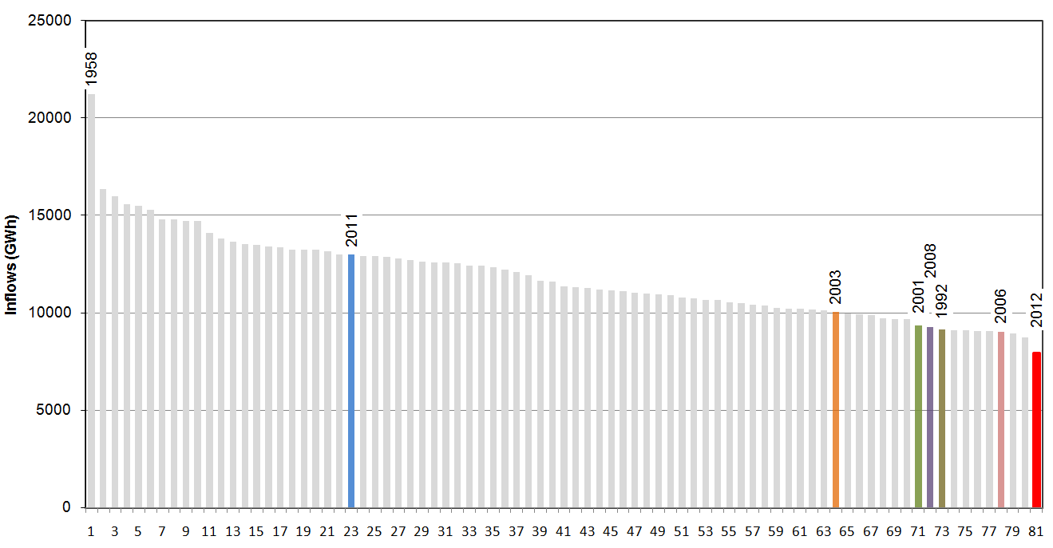
Hydro inflows for the first six months of every year (81 years to 2012)
2012 was the driest ‘first six months’ on record
Notes:
This chart shows the volume of inflows into NZ’s hydro catchments for the first six months for every year since records began 81 years ago. The 2012 year was clearly a very dry year, as was 1992, 2001, 2006 and 2008. The 2003 year was also moderately dry. Last year (not shown on the chart) was also a very dry one.
[As an aside, many people assume that climate change will reduce inflows into NZ’s large South Island hydro catchments, but that is unlikely to be the case because it is expected to strengthen westerly winds in that part of the country, driving more precipitation into the SI hydro catchments. Climate change is likely to make the North Island drier but NZ has only modest storage in the NI (mostly Lake Taupo)]

Slide 12
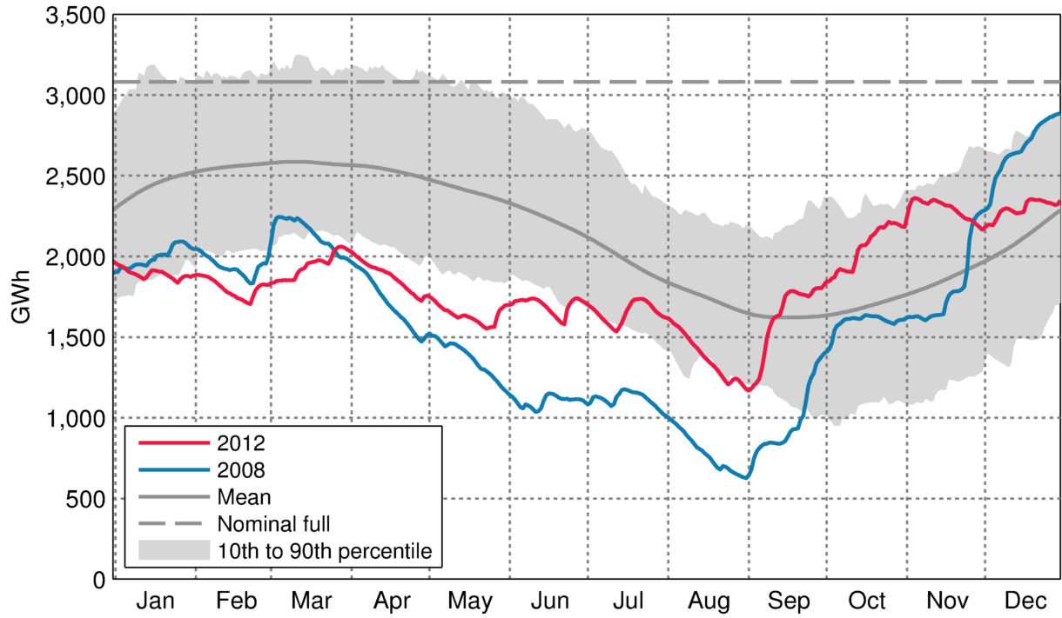
Levels of stored energy in our hydro reservoirs, 2012 v 2008
Hydro managed more prudently in 2012 v 2008
Notes:
This chart compares hydro lake levels in 2012 versus 2008, which as we saw earlier was a very difficult year for security of supply despite the availability of the Government’s Whirinaki reserve generation plant.
The chart shows that generators operated to preserve hydro lake levels earlier in the year, which preserved their option to use the water later in the winter.
This activity is consistent with the incentives on generator-retailers to avoid official conservation campaigns.
Although spot market prices jumped sharply, there was no lobbying for government intervention.
And we also saw Meridian arrange a large swaption contract with Genesis, which provides Meridian with the right to call for a Huntly unit to enter the market so that it can preserve its hydro lake levels and it provides Genesis with a known forward demand for the unit, making it easier to commercially justify keeping the units ready to provide dry year cover.
This coordination among otherwise fierce competitors is a great example of how competitive markets can find ways to coordinate complicated situations very well.
Similarly, Meridian negotiated contractual arrangements with Rio Tinto that incentivised the latter to reduce their electricity demand when certain spot market situations occurred.

Slide 13
Direct intervention (in phase II) took SOS backwards
 | Knowledge | Incentives | Decision rights
Pre 1996: Centralised phase |  |  | 
1996 – 2003: Market phase I |  |  | 
2003 – 2010: Market phase II |  |  | 
2010 – 2021: Market phase III |  |  | 
Forthcoming? |  |  | 
Notes:
Market phase II took SOS arrangements backwards because direct intervention through the Government installing the Whirinaki reserve energy plant was a time-inconsistent policy action
And so it was just a matter of time before this was revealed to be the case.
And as it turned out it only took 5 years for it to seriously harm security of supply.
Using levypayers to fund its capital costs undermined private Incentives to invest in dry year cover and the policy commitment to never run it when spot prices were short of the plant’s SRMC were not credible and so were a poor set of decision rights.
Market phase III – the current arrangements – are a significant improvement on market phase II for the reasons just discussed
But there is room for improvement.

Slide 14
Overview
Background: pre 1996
Past challenges: 1996 – 2017
  Security of supply
  Competitive pricing and behaviour
Recent challenges: 2018 – now
  Security of supply (again)
  Competitive pricing and behaviour (again)
Forthcoming challenges
  Technology change and innovation
  Carbon emissions policy
Comparative assessment
Notes:
Back in 2001 there were 5 large generators and 8 smaller ones competing in the spot market, and about 60 smaller ones connected to distribution networks and so competing indirectly.
So, to understand competitive pricing behaviour in the spot market it is important to understand the concept of a pivotal generator.
A generator is pivotal when national electricity demand cannot be met without drawing some output from that generator.
That is, with all other generators producing flat out, there is insufficient generation to meet national electricity demand and so electricity from the pivotal generator is absolutely needed to avoid forced demand shedding.
You can see that this means a pivotal generator has the ability to set the spot market price to essentially whatever level it likes.
And that’s what happened on 26 March 2011, which everyone in the sector refers to as Super Saturday
Genesis Energy drove spot prices to around $20,000/MWh for 8 hours for a large parts of the North Island, taking advantage of a planned transmission outage by Transpower.
After extensive investigation, the EA decided the event was an Undesirable Trading Situation (UTS) and reset spot prices to ~$3,000/MWh, which was still seen as extraordinarily high.
We decided the event was a UTS because had any one of five unusual factors not occurred, the event would not have occurred.
The most important factor was that on previous day Transpower had greatly underestimated electricity demand for 26 March, and so the high offer prices Genesis had placed in the stack didn’t come through in the form of forecast prices. Industrial consumers said they would’ve cut their demand if they had known that $20,000 prices might occur.
Another key factor was that Contact Energy had withdrawn their new Stratford gas peaker plant for further refinement, and told the investigation they wouldn’t have done had they thought spot prices would be $20,000.
There were other factors too, but in essence the EA took the view that the market had malfunctioned due to poor information, and inefficient generator incentives due to a transmission outage, and so letting the event stand would undermine confidence in the market.
So this is a round about way of saying the regime for dealing with market power events were just the UTS provisions in the rulebook, which derived from the days when the spot market was self-regulated by the electricity industry. Just about all electricity and financial trading markets have UTS type provisions, to allow the market provider to deal with rare and unforeseeable dysfunctional situations.
And of course the more general anti-competitive conduct provisions in the Commerce Act are also relevant for generator trading behaviour.
Other more localised pivotal pricing events occurred in 2013, again when transmission outages occurred.
The very high prices were not to cover the costs of plants sitting idle the vast bulk of time, waiting for these kinds of circumstances to occur. Rather, they’re plants that would often run in the market. Coming shortly after Super Saturday, these events led to two concerns at the EA:
The first concern was that spot market purchasers were losing confidence that high wholesale prices were anywhere near efficient levels
Our main concern was that more frequent UTS allegations were occurring, which in our view carried a real risk the EA would be drawn into regularly setting spot prices or at the minimum undertaking costly and time-consuming investigations, leaving the market with heightened uncertainty for prolonged periods.
These concerns led to the introduction of trading conduct rules in 2014, which is now the other key feature of the regulatory regime for dealing with periods of weak competition.
The key idea was to incentivise competitive pricing during pivotal periods by creating a “safe harbour” from enforcement action if price offers in pivotal periods were similar to neighbouring periods when they were not pivotal or if the generator is actually a net buyer from the spot market when it is pivotal. If it is a net buyer then it has incentives to push spot prices down, not up.
In essence, the idea was to avoid lengthy investigations by having a pragmatic method of rejecting allegations of seriously inefficient trading behaviour, and also it was my hope the creation of the safe harbour created incentives for generators to ensure they’re within it when they’re likely to be pivotal.
I was hoping for a ‘win-win’ for consumers and generators.
The thing about this approach was that I had not anticipated an advisory group of industry participants coming up with the concept of a ‘high standard of trading conduct’ (HSOTC), and I had not anticipated the EA staff and Board going along with this – but of course, being a government agency, how could it not?
The great problem with this component of the proposed rules was that it was impossible to practicably define a high standard of conduct and so it went undefined, causing ongoing concerns that in my view undermined the overall intent of the scheme which was to have a pragmatic safe harbour.
So, the EA’s regulatory regime for periods of weak competition now comprises both UTS and trading conduct rules, each requiring long investigations!

Slide 15
Overview
Background: pre 1996
Past challenges: 1996 – 2017
  Security of supply
  Competitive pricing and behaviour
Recent challenges: 2018 – now
  Security of supply (again)
  Competitive pricing and behaviour (again)
Forthcoming challenges
  Technology change and innovation
  Carbon emissions policy
Comparative assessment
Notes:
Now that we’ve covered the history of where the market is at, let’s turn to the more recent challenges facing the electricity market.
The supply challenges before 2018 were temporary events, arising from dry weather leading to low hydro inflows in our main hydro storage catchments, especially Pukaki.
We call them “dry year” events but they never last more than 3- 4 months.
It is clear that the current supply challenges are more than temporary hydro events (see next slide).

Slide 16
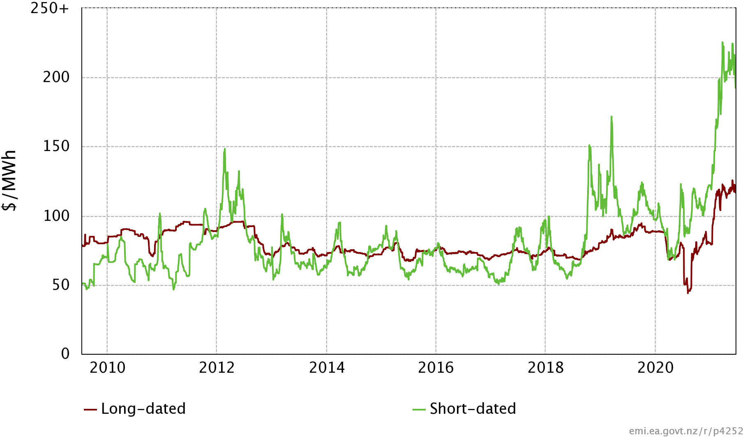
Baseload futures prices at Benmore
Serious medium-term supply problems have developed since October 2018
Tiwai flip flop
Notes:
This chart shows baseload futures prices at Benmore in South Canterbury.
The green line are prices for short-dated futures contracts, which are any contracts maturing within 12 months.
The brown line are prices for contracts maturing over the next 1 – 4 years.
You can see that within-year hydro conditions affect shorted-dated contract prices but not prices for long-dated contracts.
BTW, you can think of baseload futures as the financial analogue to a geothermal generation plant, producing the same amount of output 24x7 for every month of the year.
In essence, a baseload futures contract allows the contract holder to pay a set electricity price for a fixed amount of energy for every half hour for the duration of the contract.
Which means the holder only pays the spot price on their level of demand in excess of their contracted volume.
Since October 2018, a suite of medium-term supply issues have developed:
In early 2018 the Govt announced a ban on offshore oil & gas exploration, which took the gas and electricity sectors by surprise but didn’t seem to move futures prices at all.
By Oct 2018 problems with Pohokura gas supply became evident, greatly reducing gas flexibility to feed ‘dry year’ generation.
Also in 2020 the Govt doubles down on its 100% REG target by bringing it forward to 2030 (from 2035)
This is despite analysis from the Interim Climate Change Committee (ICCC) showing that going from 98% to 100% is likely to increase wholesale prices by 40% and increase GHG emissions overall.
The Tiwai ‘flip flop’ also occurred in 2020, which greatly reduced prices for long-dated futures, presenting an excellent opportunity for hedging at low prices for several years ahead.
Mixed in with this are some temporary dry year issues, one in Feb/Mar 2019 and another one in Mar – April 2021.
The Minister of Energy publicly pushed back on industrial consumers arguing for her intervention, saying they chose to under-hedge in the expectation of low spot prices and so they need to lie in the bed they made for themselves.
Although I feel for the unhedged industrial consumers, I was heartened by the Minister’s statements as it suggests the stress testing regime is proving beneficial regardless of the colour of the government.
Underpinning the extraordinarily high short-dated prices in 2021 are that:
I understand from another seminar that diesel prices have risen to levels equivalent to $200-$300 per MWh, which means when Whirinaki is operating spot prices are reaching $300 - $400 per MWh
Also, spot market gas prices are 3 – 4 times higher than has been the case for many years, due to reduced gas field deliverability.
And so that will also be driving short-dated contract prices above $200 for the first time.
Long-dated prices have also risen above $100 per MWh, which I understand reflects generators reassessment of the medium term risks arising from reduced gas flex and deliverability.
It seems to me that the customer compensation scheme is once again providing appropriate incentives for generators to address these issues by arranging demand reductions with their industrial customers, such as occurred with the Tiwai smelter, and increasing their gas generation capabilities by negotiating gas swaps with the largest gas user in the country, Methanex.

Slide 17
Overview
Background: pre 1996
Past challenges: 1996 – 2017
  Security of supply
  Competitive pricing and behaviour
Recent challenges: 2018 – now
  Security of supply (again)
  Competitive pricing and behaviour (again)
Forthcoming challenges
  Technology change and innovation
  Carbon emissions policy
Comparative assessment
Notes:
In the interests of saving time, I’m going to discuss this issue quickly, but I’m happy to come back to it at question time if people wish. Two matters I’ll skip over is the Nov/Dec 2019 UTS event and the recent decision by the EA to replace the existing trading conduct rules with a more theoretical approach.
One point I want to make, though, is that there has been a rapid reduction in gas sector investment and workforce. With new coal- and diesel-fired reserve generation not politically palatable, there is very little scope for new parties to build generation to provide dry year cover, reducing competitive pressure in the market.
This basically kills any chances for large energy-intensive consumers to negotiate a multi-year power purchase agreement (PPA) with a generator bringing on new sources of wind or solar energy, because industrial consumers use a constant amount of power 24x7.
If a wind or solar generator agreed to such a PPA it would either need it would need a cost-efficient way of covering for times when their generation was not operating.
One option is to buy from the spot market to cover those periods, but spot prices tends to be high when intermittent generation is low because market supply tends to be tight at those times.
Usually another good option is for suppliers of a PPA to invest in their own gas peaker, but that isn’t feasible under the current gas industry situation.
This leaves new geothermal generation as the primary option for making a PPA with industrial consumers, however there are only two existing generation companies (Contact and Mercury) with significant experience in that technology and obtaining resource consents is time-consuming.
So, for the medium-term, it appears the market for dry year cover looks to be rather concentrated and competitive pressures probably weaker than they have been for many years.
-----
Nov/Dec 2019 hydro flooding event
South Island spot prices remain ~$100/MWh despite flooding in our main SI hydro schemes
EA decides the event was a UTS … reset spot prices to ~$6/MWh
EA decides generator offering decisions do not breach trading conduct rules (ie HSOTC rules)
Ongoing high wholesale prices
Context 1: retailers/industrial consumers regularly complain about high wholesale prices but don’t secure own generation
Context 2: significant medium-term supply issues, and so wholesale prices should rise appreciably?
EA is replacing HSOTC rules with more theoretical approach
Reason 1: the safe harbour provisions could lead to outcomes that are inconsistent with intended purpose of the rules
Reason 2: replace vague notion of ‘high standard of trading conduct’ with a standard economic efficiency framework
Key idea: generators must always offer into spot market as if no generator has significant market power
But, for all practicable purposes, the concept of significant market power is undefined and I would expect similar issues arising as occurred with the high standard of trading conduct.
Market power becomes significant when its exercise would have a net adverse impact on economic efficiency, which includes productive, allocative and dynamic efficiency.
The Authority considers that options involving direct intervention in the market (be it through offer or price caps or structural measures) would be unduly prescriptive and more administratively complex and costly to implement when compared to the apparent problem they seek to resolve.
However, the Authority will reconsider these options if the proposed trading conduct rule is not effective at deterring the exercise of significant market power in the wholesale electricity spot market when competition is weak.

Slide 18
Overview
Background: pre 1996
Past challenges: 1996 – 2017
  Security of supply
  Competitive pricing and behaviour
Recent challenges: 2018 – now
  Security of supply (again)
  Competitive pricing and behaviour (again)
Forthcoming challenges
  Carbon emissions policy
Notes:
As I expect you know well, the Government’s approach to achieving net-zero carbon by 2050 involves electrification of transport & industry process heat
Which Transpower has estimated may increase electricity consumption by 55-70% over next 30 years and increase generation capacity by 170%, with flow on implications for T&D capacity requirements.
The build opportunity over the next 30 years is likely to be great for enhancing generator competition generally, and I have no doubts new supply will come on the market to meet demand increases provided consenting decision-making is timely.
There has been concern in some quarters that generators will wait until demand and prices pickup, resulting in periods of under supply.
But in my view existing and prospective generators have strong incentives to add new supply to match new demand because those that bring new generation on first get the first crack at securing new customers and new hedge contracts.
This is especially so when interest rates are extraordinarily low, as the opportunity cost of carrying spare capacity until demand picks up is low
Which I think explains why all four of the largest generators have announced plans to build additional wind generation in the near future
Gary Holden has announced imminent plans to build a large solar far up north
And in recent weeks I’ve become aware of real interest in the NZ market from international players.
I mentioned a few minutes ago that the medium term prospects are not bright for competitive provision of dry year cover, but the longer term prospects look promising.
One of the future commercial possibilities is for large scale wind generation to be built to supply a hydrogen plant, because technologically it doesn’t need a steady source of power.
Hydrogen is seen by its commercial backers, Hiringa Energy, as a key solution for decarbonising heavy transport.
They are racing to bring in hydrogen-powered trucks and are installing hydrogen fuelling stations in the NI, seeking to get ahead of inevitable competitors.
But in addition to fuelling trucks, hydrogen could be stored for conversion back to electricity when the hydro lakes are low
Although the technology would need to improve to make that a commercially viable prospect,
As hydrogen production and storage technology is consistent with competitive provision,
It seems to me there is a prospect of greater plurality and competition eventually developing in the provision of dry year cover, say beyond the next 5-10 years.

Slide 19
Overview
Background: pre 1996
Past challenges: 1996 – 2017
  Security of supply
  Competitive pricing and behaviour
Recent challenges: 2018 – now
  Security of supply (again)
  Competitive pricing and behaviour (again)
Forthcoming challenges
  Carbon emissions policy
  Technology change and innovation
  Carbon emissions policy
Comparative assessment
Notes:
As I’m running out of time, I will skip over discussing the particulars about technology advances.
As most of you will know, the basic story is that prices are falling fast for everything small scale, such as for rooftop solar; batteries and sensors.
And of course the proliferation of EVs is expected to add to the battery storage capacity and introduce greater mobility of demand and supply.
All of this suggests that generation, storage and demand-response services will proliferate on distribution networks, resulting in two-way power flows like occurs on the transmission grid.
Just as rapid advances in computing technology in the 1980s made competitive wholesale markets viable, these developments look likely to transform the distribution and generation markets, but I won’t go into the details about that except to say it looks very positive for further enhancing competition in the generator market and reducing prices paid by consumers.

Slide 20
Low confidence in competition
Government targets & direct intervention
The current RMA and poor-quality RMA reform
Conventional views about spare transmission capacity
Technology colliding with monopoly lines businesses
Workforce capacity issues?
Key challenges facing the sector
Notes:
Already covered the first challenge regarding low confidence regarding competition in the wholesale electricity market.
Another key challenge is Government reversion to direct intervention, and especially in matters relating to dry year cover the Government’s approach is a major challenge for the sector
The REG targets are illogical & infeasible, and so may be creating investor uncertainty. Happy to discuss why the targets are infeasible.
The prospect of direct intervention in the form of the proposed Lake Onslow scheme is very problematic in my view, and carries the same time consistency problems the 2003 reserve energy scheme had
Also, it is too risky and costly, for reasons I’m happy to elaborate on later:
MBIE suggests it may take just 4-5 years to build it, and another 2 years to fill it, but many are suggesting these timelines are wildly unrealistic
Others have suggested it could take 5 years to fill it, and once used there is no guarantee the following year will be wet so that it can be refilled for the next dry year
It potentially leaves all of our dry year cover in the SI, which means it fails to reduce the NI’s reliance on the HVDC and the NI transmission system
The large size of the scheme means it will be undermining private incentives to pursue other dry year cover opportunities until they know whether the Government decides whether or not to build it.
It also undermines investor incentives to provide cover for peak demand periods.
Another worrying development is central and local government direct intervention in rolling out EV charging, often providing the service for free and so undermining private provision.
The thinking in this space seems to confuse network effects with rolling out a network of charging stations.
Network effects refer to situations where users gain more value from a service the greater the number of users of that service.
It’s a classic positive externality situation, and so there can be a public policy case for encouraging the rollout of those services.
The classic example of this telecommunications networks, but trading markets are another important example.
But there are no network effects from EV charging as having more people wanting to use EV chargers reducing customer convenience.
Rather, EV chargers are a complement with EVs, because the more EVs there are the greater the demand for EV chargers.
So, the business of supplying EV charging services is one that can be safely left to private providers and it is best that Government does that.
Instead, the government needs to focus on removing regulatory barriers to businesses serving customer demand.
We’ve already talked about the fragile gas market and implications for dry year cover and so won’t dwell on it
There is considerable uncertainty about the pace and timing of demand growth, and in particular if or when the Tiwai smelter exits
However at this stage it doesn’t appear to be a significant issue b/c exceedingly low interest rates
But with both major political parties having promised intervention to defer Tiwai closure in the 2020 election, the worry has to be that if generators collectively under forecast demand then either political party could revert to direct intervention.
This would most likely be in the form of directly building new generation or requiring the EA to design and introduce a mandatory capacity market, which sad to say many overseas jurisdictions have adopted and many market participants often lobby for in NZ.
The one glimmer of hope is that it should be more obvious these days that such interventions are not likely to be well-suited to NZ’s particular circumstances, which are energy rather than capacity challenges.
Capacity markets, for example, would be akin to a government agency holding a tender for more petrol stations to be built and supply petrol when the issue is the lack of fuel at existing stations!
Another big challenge, and probably the biggest, is the current RMA and RMA reform
Old paradigm: local generation v local environment
New paradigm : global environment v local environment?

Slide 21
Low confidence in competition
Government targets & direct intervention
The current RMA and poor-quality RMA reform
Conventional views about spare transmission capacity
Technology colliding with monopoly lines businesses
Workforce capacity issues?
Key challenges facing the sector
Notes:
Another big challenge, and probably the biggest, is the current RMA and RMA reform
The current paradigm for consenting REG is that the choice is between local REG v local environment, and so it makes sense to leave the decision to the local authorities.
But if the consenting process hinders REG consenting too much then the choice becomes one of meeting our global environmental commitments v local environment.
Under this scenario it doesn’t make sense to leave the consenting decision solely to territorial authorities.

Slide 22
Low confidence in competition
Government targets & direct intervention
The current RMA and poor-quality RMA reform
Conventional views about spare transmission capacity
Technology colliding with monopoly lines businesses
Workforce capacity issues?
Key challenges facing the sector
Notes:
Conventional views about spare transmission capacity
Again, the current paradigm is that Transpower faces zero financial risk from over-building transmission capacity and so it is important to adopt a beneficiaries pay regime for transmission pricing to bring counteracting forces to bear on the decision-making process.
But if REG is to be built quickly, and the RMA and successor Acts seriously hinder consenting them, then it may be preferable to over-build transmission in areas with good natural resources for renewable generation … but not charge users for spare capacity.
The converse of lack of transmission capacity resulting in supply shortages will not likely be tolerated by voters or politicians, and it seems likely that direct intervention will occur.
A similar issue applies to distribution capacity. It will be very important for consumers to understand that they have to pay for network upgrades if they’re need for them to use fast chargers drawing power from the network.
This brings me to the issue of technology colliding with monopoly lines businesses.
With local networks having two-way power flows, they will need to acquire more sophisticated system operation capabilities and network support services, such as demand response services.
This raises the issue of the best form of collaboration among networks, either through sub-contracting or joint ventures or perhaps mergers.
I am not confident the performance incentives under the Commerce Commission’s price control regime are strong enough for the best choices to be made about this.
For example, perhaps mergers would be out of question given the networks are largely trust owned, are not listed and so takeovers are not easy steps to take.
Conversely, the regulated monopoly features of EDBs means they have strong incentives to own and control distributed energy resources (DER) connected to their networks, rather than obtain their assistance through service provider contracts, and participate in the wholesale markets in ways that undermine generation market?
Workforce capacity issues shouldn’t be an issue if they’re dealt with sensibly by government in regard to their border and tertiary education policies, but who knows with Covid.

Slide 23
The challenges suggest we are at serious risk of security of supply arrangements going backwards
 | Knowledge | Incentives | Decision rights
Pre 1996: Centralised phase |  |  | 
1996 – 2003: Market phase I |  |  | 
2003 – 2010: Market phase II |  |  | 
2010 – 2021: Market phase III |  |  | 
Forthcoming? |  |  | ?
Notes:
The red scores in this slide reflects the Government’s unhealthy pursuit of direct interventions like the Lake Onslow scheme, undermining private incentives to provide for security of supply and potentially concentrating decision rights during dry year events in the hands of one major player.
In my view a far better approach would be for the Govt to strengthen current market arrangements by abandoning its ‘100% by 2030’ target and its investigation into the Lake Onslow scheme.
Instead, it should promote the NZ electricity market as providing an open and level playing field for participants to supply dry year cover. It should pursue obliquity and eschew direct intervention.
In saying this, I am assuming it is obvious to the ComCom it should be very wary of approving acquisitions likely to hinder reductions in the concentration of the provision of dry year cover, and so nothing more needs to be considered on that front.
I do have a longer-term pro-competition effort I think the EA should pursue, but while that’s developing I think it would be a good move in the meantime for the EA to re-instate pragmatic and revised safe harbour provisions within their new trading conduct rules, with the ‘net buyer’ component being an obvious one to reinstate.
In my view this could reduce provide incentives for generators to compete more aggressively in the hedge markets to move their books to a net buyer position.
And this could also assist with my next suggestion (next slide).

Slide 24
Facilitate
a robust market in standardised cap contracts
A suggestion
Notes:
My biggest concern from the challenges we’ve just covered is that consenting arrangements will lead to a period of under supply of electricity, leading a future Government to require the EA to introduce a capacity market or a single buyer regime.
To minimise these risks, and to achieve better security of supply arrangements and improve competitive pricing, I think the EA should facilitate a robust market in standardised financial cap contracts (or alternatively in standarised option contracts).
The easiest way to understand cap contracts is that are an basically insurance product – the purchaser pays a premium for a specified level of demand and in return avoids paying on that quantity any spot prices exceeding the contract’s strike price.
At the EA we undertook a lot of work developing two cap products in 2017 – one providing a price cap at $120/MWh to cover dry year events and another at $250/MWh to cover weekday price events.
We ended up being stymied by developments in Australia, where the ASX – who was also open to listing these products –had to deal with a curve ball from the RBA and ASIC regarding the treatment of financial exposures, which I presume has been sorted by now, and if not, go to another platform provider.
There is likely to be good demand for cap products from the swag of new wind and solar generators wishing to grow a customer base, from independent retailers and from existing vertically integrated generator-retailers with their own wind and solar generation units. Hopefully, there is also likely to be demand from industrial consumers the next time they decide to forgo baseload futures contracts.
The suppliers of intermittent sources of energy – such as gas-fired plants, hydrogen and battery operators - or demand reduction – such as cool stores or hydrogen producers – would be natural counterparties for the $250 cap product.
Suppliers of dry year cover – such as gas fired plants or hydrogen plants or pumped storage plants or smelters and methanol with seasonal flex capabilities – would be the natural counterparties for the $120 product.
Facilitating a market for standardised caps makes good public policy sense, as these kinds of markets provide net social benefits but they suffer from ‘chicken and egg’ problems, or what economists call network effects.
A ‘chicken and egg’ problem arises because the commercial value such a market provides to each participant is strongly influenced by the volume of activity on the market, and therefore by the number of users.
The public policy benefits come from reducing entry barriers for renewable energy providers – especially for wind, solar and battery.
And from reducing uncertainty for providers of dry year and intermittent cover and making their propositions more bankable.
A standardised cap contracts market would also bring greater transparency to the costs and risks of provisioning dry year cover.
And it could also reduce incentives to exercise market power during dry year events.
In my view this is the single most useful step the EA could take to improve knowledge, incentives and decision rights regarding security of supply, and it would also have the added benefit of further enhancing competition in the wholesale market.
Another suggestion is that the EA work with EDBs and DERs to establish flexibility markets for the purchase of support services, as a step towards eventually adopting full system operation.

Slide 25
A robust caps market could yield better outcomes
 | Knowledge | Incentives | Decision rights
Pre 1996: Centralised phase |  |  | 
1996 – 2003: Market phase I |  |  | 
2003 – 2010: Market phase II |  |  | 
2010 – 2021: Market phase III |  |  | 
Forthcoming: Market phase IV |  |  | 
Notes:
Improving knowledge, incentives and decision rights is likely to yield better outcomes than now, and certainly better outcomes than targets and direct intervention:
Better carbon outcomes
Better security of supply outcomes than would be achieved through direct intervention
And also improve confidence in wholesale market competition and therefore confidence in wholesale market prices.

Slide 26
carl.hansen@CapitalStrategicAdvisors.com
Questions

