Slide 1
LESSONS FROM VODA/SKY - DO WE HAVE THE RIGHT MERGER CONTROL SETTINGS FOR A SMALL OPEN ECONOMY?

Slide 2
LESSONS FROM VODA/SKY - DO WE HAVE THE RIGHT MERGER CONTROL SETTINGS FOR A SMALL OPEN ECONOMY?

Slide 3
Recap: What was the decision and why?
Applications for clearance for Sky TV and Vodafone NZ to merge was declined
NZCC’s grounds for declining were that it could not exclude a real chance that:
the merged entity would leverage market power over premium live sports content, foreclosing competition in the medium to long term in broadband and mobile services markets
the merged entity would have ability (and incentive) to use market power over premium live sports content to supply attractive bundles which others could not match
the competitively significant players in the broadband and mobile markets would suffer a significant loss of scale

Slide 4
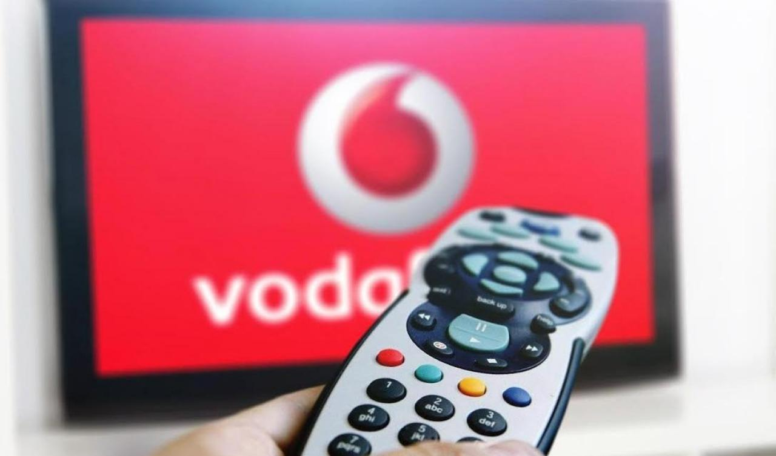
Where has this ended up?
Vodafone announced Vodafone TV on 16 October 2017
NZCC may be considering its position, but has taken no action
Photo credit: Newshub

Slide 5
LESSON 1 – MIND THE GAP
Photo credit: The Telegraph

Slide 6
Mind the Gap
The threshold to decline clearance is low
“Specifically, the Commission cannot exclude a real chance that the merged entity would leverage its market power over premium live sports content, foreclosing competition in the relevant broadband and mobile services markets over the medium to long term.”
It has been set this way by the New Zealand courts:
Woolworths (HC) at [113]: “… a real and substantial risk might be one that had at least a 30 per cent prospect” – this decision was overturned on appeal
Woolworths (CA) at [107]: “… We are reluctant to engage with any argument as to the width of Mr Goddard’s “gap”…”

Slide 7
Mind the Gap
“likely” does not mean “more likely than not”
In practice it means, “is there sufficient evidence to support a prima facie case of a risk that a substantial lessening of competition might arise”?
Compare to the Australian test:
Metcash: “The assessment of the risk, or real chance, of a substantial lessening of competition cannot rest upon speculation or theory. The Court is concerned with commercial likelihoods relevant to the proposed acquisition. The application of the word likely, and the assessment of the substantial lessening of competition, must both be carried out at a level that is commercially relevant or meaningful”

Slide 8
Mind the Gap
How wide is the “gap”?
No question – it is a difficult balance and the outcome is highly fact-dependant
But:
competition regulators are traditionally more concerned with Type II errors – “false negatives”, and
Courts tend to be more concerned about Type I errors – “false positives”
=> This could lead to different outcomes under the same test

Slide 9
Mind the Gap
Vodafone TV appears to have implemented the market innovations intended for the merger
Mergers can be more efficient:
In similar firms, organizational processes are more efficient within a single firm, allowing greater synergies and avoiding costly and time-consuming negotiations among management (Garette and Dussauge (2000), European Management Journal)
There appears to be a case for considering whether there should be some amendment to s47
Should “likely” mean “on balance, more likely than not”?
Should there be other evidential standards imposed on the “prima facie case” standard to bring it more in line with Metcash?
Should there be any policy preference at all in favor of the Commission’s merger control processes being utilized?

Slide 10
Lesson 2 – If all you have is a sledgehammer, then you will use it to crack the nut
Photo credit: University of Melbourne

Slide 11
If all you have is a sledgehammer, then you will use it to crack the nut
Dr Berry said had the merger not included Vodafone acquiring all of the premium sports content, it would have likely have been approved.
"The problem we have is that there is this major customer segment for who SKY Sports is a must-have, and the merged entity would have the ability to leverage that market power to potentially have an adverse impact on Vodafone and SKY's rivals.“
- Newshub

Slide 12
If all you have is a sledgehammer, then you will use it to crack the nut
Spark had suggested a Deed of Undertaking, modelled on a UK deed, drawing on Australian concept of sports of national significance (see Spark’s submission on LOUI at [15]):
wholesale must offer on retail minus basis
premium sports content
no unduly restrictive key commitments
non-discrimination – this is a common feature of telco undertakings
Self-monitoring - it permitted third parties to litigate failure to comply with the deed in the High Court, so NZCC did not need to police it

Slide 13
If all you have is a sledgehammer, then you will use it to crack the nut
Recent cases suggest NZCC taking a less “dry” economic approach
It has been unwilling to accept views of lack of barriers to expansion that it has accepted in the past
other jurisdictions with a more interventionist have the tools to ensure that approach is adequately measured to the harm – especially important in telco and content markets where partnering is common
NZCC can only accept structural undertakings (s69A)
If there are no business units to divest, this creates a binary outcome – clear or decline
Businesses that have faced material disruption often respond through integration initiatives to drive cost savings
These businesses may need the efficiencies mergers can deliver

Slide 14
If all you have is a sledgehammer, then you will use it to crack the nut
NZ is pretty much alone in this jurisdictional incompetence
Every other major regulator has
the ability to accept behavioral undertakings, and/or
Operates in a more sophisticated regulatory construct where regulation deals with content lock ups
There is a case for reform of s69A. NZCC needs the ability to accept appropriate behavioral undertakings

Slide 15
Lesson 3 – Time kills deals
Picture credit: Google

Slide 16
Time kills deals
Application took 8 months to be decided
Clearance application filed 29 June 2016
SOPI 14 July 2016
LOUI 31 October 2016
Determination 22 February 2017
Multiple rounds of OIA requests for information
Information disclosed on a counsel only basis
Substantive notice of appeal filed 17 May 2017, abandoned 26 June 2017
Deal value: USD$2.3b

Slide 17
Time kills deals
Timeframes for similar decisions overseas:
Comcast/Time Warner Cable (2000)
Competition process took just over a year – withdrawn (57% US BB, 30% Pay TV)
Deal value: US$45b
Charter Communications / Time Warner Cable (2016)
Competition process took almost a year – approved with behavioural commitments (not entering into or enforcing agreements that make it more difficult for online video distributors to obtain video content)
Deal value: US$78b
SFR/Télé 2 France (2007)
Competition process took almost 8 months – approved with behavioural commitments (non-discrimination re TV content)
Deal value: 3.3b SEK (US$450m)
Liberty Global / BASE Belgium (2015)
EC assessment took 5.5 months – approved with behavioural commitments (sale of customer base)
Deal value: €1.33b
Vodafone / Ziggo (2016)
EC Competition process took less than 2 months – approved with behavioural commitment (sale of Vodafone Home fixed retail customer base)
Deal value: combined aggregate worldwide turnover of 500m€
B Sky B / Kirch Pay TV (2000)
EC Competition process took less than 3 months – approved with behavioural commitments (interoperability and rights acquisition undertakings)
Deal value: €510m

Slide 18
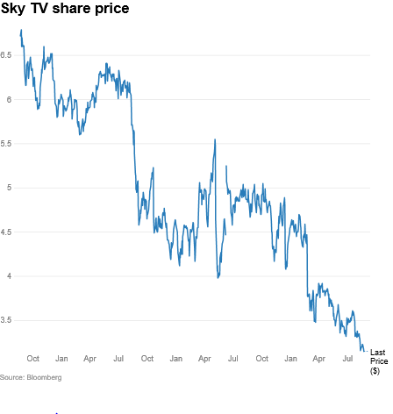
Time kills deals
John Fellet (NZ Herald):
"My attorneys were telling me the merger could take a year, we could probably bank on it being at least a million dollars and then it would still be a coin flip on whether you win or lose."
A lot can happen in a year…
There is a case for NZCC to reconsider its processes, including around confidentiality and disclosure, to reduce timeframes for consideration of complex mergers

Slide 19
Thank you!
Sarah Keene
Partner
D +64 9 367 8133
Sarah.keene@russellmcveagh.com

