Slide 1
Digital Platforms Inquiry Findings and Recommendations Presentation to LEANZ
Morag Bond, Joint General Manager (job-share with Kate Reader)
17 October 2019

Slide 2
Contents
Background
Scope of the Digital Platforms Inquiry
Inquiry process
Findings and recommendations:
Market power, competition and advertising markets
Digital platforms and media businesses
Digital platforms and news and journalism
Digital platforms and consumers
Final thoughts

Slide 3
Background and Context
This Inquiry was part of 2017 media reform package which abolished the two-out-of-three ownership and 75% reach rules
Underlying concern with how digital platforms have impacted advertising and media markets
Particularly the consequences of digital platforms increasing share of advertising expenditure for news and journalism
One of a number of ACCC inquiries directed by the Treasurer (others include retail electricity pricing, residential mortgage prices).

Slide 4
Scope of the Digital Platforms Inquiry – Direction
Federal Government direction to ACCC on 3 Dec 2017
Terms of Reference: the ACCC to look into the impact of digital search engines, social media platforms and ‘other digital content aggregation platforms’on the state of competition in media and advertising services markets, in particular in relation to news and journalistic content and the implications of this for media content creators, advertisers and consumers.

Slide 5
Scope of the Digital Platforms Inquiry – Direction
The Direction identified a number of matters to be looked at, including:
the extent to which digital platforms are exercising market power
the impact of digital platforms on the level of choice and quality of news and journalism
the impact of information asymmetry between digital platforms, advertisers and consumers on competition in media and advertising markets.

Slide 6
Information collection and stakeholder engagement
Submissions process
70 public submissions to Issues Paper
129 public submissions to Preliminary Report
Compulsory information requests
more than 60 compulsory notices issued under s95ZK of the Competition and Consumer Act 2010 (Cth)
Meetings
Forums
Stakeholder forum - March 2019
Future of journalism roundtable - March 2019
Privacy roundtable - March 2019
Small Business and Franchising Consultative Committee meeting - February 2019
Plus four forums pre the publication of the Preliminary Report.

Slide 7
Information collection and stakeholder engagement
Close engagement with other Australian government departments and agencies
Frequent contact with overseas agencies
Commissioned reports (available on ACCC website)
The Impact of Digital Platforms on News and Journalistic Content, CMT, UTS
Public funding of high-quality journalism (Phase 1) and case studies (Phase 2)
Consumer surveys

Slide 8
Key Findings and Recommendations: Market power, competition and advertising markets

Slide 9
Market power findings
Google has substantial market power in the supply of:
general search and
search advertising
Facebook has substantial market power in supply of:
social media services and
display advertising
Data/access to data points has contributed to the substantial market power held and assists expansion into other markets.
Strategic acquisitions which have contributed to their substantial market power.

Slide 10
Market power and competition findings
Google and Facebook each have the ability and incentive to favour their own related businesses or businesses of partners
role as gateways/substantial market power
opacity of their operations
activities in related markets
A lack of transparency in online advertising especially in the ad tech supply chain which delivers programmatic advertising.
Why the focus on Google and Facebook?
- By far the largest digital platforms in Australia
Time spent by Australians on Google and Facebook dwarfs all other online use
- Concerns raised related to Google and Facebook.

Slide 11
Market power and competition recommendations
Rec 1: New merger factors
the likelihood that the acquisition would result in removal of a potential competitor
the nature and significance of assets, including data and technology being acquired
Rec 2: Advance notification
Rec 3: Changes to search engine and internet browser defaults

Slide 12
Other competition related recommendations
Rec 4: Proactive investigation, monitoring and enforcement of issues in markets in which digital platforms operate
Rec 5: Inquiry into ad tech services and advertising agencies

Slide 13
Direction for future ACCC work: Data portability
ACCC to revisit the applicability of the Consumer Data Right (CDR) to digital platforms in the future
ACCC recognises that portability of data held by digital platforms may deliver significant benefits to current and future markets
But the ACCC considers that data portability is unlikely to have a significant effect on barriers to entry and expansion in the short term.

Slide 14
Key Findings and Recommendations: Digital platforms and media businesses

Slide 15
Digital platforms and news media businesses: regulatory imbalance
Regulatory imbalance between news media businesses and digital platforms. Two consequences:
can distort competition by providing digital platforms with a competitive advantage because they operate under fewer regulatory restraints and have lower regulatory compliance costs than other media businesses
overall effectiveness of current media framework is reduced.

Slide 16
Recommendation to address regulatory imbalance
Rec 6: Process to implement harmonised media regulatory framework

Slide 17
Digital platforms and news media businesses: bargaining power imbalance
As well as being rivals, digital platforms are also essential business partners of digital platforms
Each of Google and Facebook have substantial bargaining power vis-à-vis news media businesses
Concerns raised by news media businesses included:
implementation of policies/formats that impact the ability of the news media business to monetise their brand and therefore audience
impact of policies on the incentives to produce original content.

Slide 18
Recommendation to address imbalance in bargaining power
Rec 7: Codes of conduct to govern relationships between digital platforms and media businesses

Slide 19
Digital platforms and news media businesses: copyright
Both established media businesses and smaller owners of copyright protected content face difficulties in enforcement copyright against multinational digital platforms
Rec 6: Mandatory ACMA take down code to assist copyright enforcement

Slide 20
Key Findings and Recommendations: Digital platforms impact on news and journalism

Slide 21
Digital platforms impact on the production of news and journalism

Slide 22
Digital platforms impact on the production of news and journalism
A significant reduction in certain categories of public interest journalism:
local government reporting
local court reporting
health reporting
science reporting
106 local newspapers closed from 2008 to 2018
21 local government areas left without any coverage.

Slide 23
Digital platforms impact on the production of news and journalism
Why does this matter?
Provides benefits to individuals – increasing their knowledge
But also important benefits to society:
holding the powerful to account
campaigning for social goals
keeping a journal of record
providing a forum of ideas

Slide 24
Digital platforms impact on the consumption of news and journalism
Digital platforms have likely contributed to the increased media voices in Australia by facilitating the entry of digital native publishers
Australian consumers accessing news through digital platforms may be at greater risk of exposure to unreliable news, including disinformation and malinformation, than those accessing news and news from other sources
The use of algorithms to curate news plus user behaviour on social media have the potential to cause ‘filter bubbles’ but the extent of any harm caused by these effects is not clear
Digital platforms are taking action to address journalism consumption issues and the prevalence of disinformation and malinformation on their services
These approaches are not yet applied consistently across international jurisdictions.

Slide 25
Recommendations to address news and journalism concerns
Rec 9: Stable & adequate funding for the national broadcasters
Rec 10: Grants to support local journalism (identified as an area at risk of under production)
ACMA
Rec 11: Tax settings to encourage philanthropic support for journalism

Slide 26
Recommendations to address news and journalism concerns
Rec 12: Improving digital media literacy in the community
Rec 13: Digital media literacy in schools
Rec 14: Monitoring digital platforms’ efforts to implement credibility signalling
ACMA
Rec 15: Industry code to govern digital platforms’ handling of complaints about disinformation
ACMA

Slide 27
Key Findings and Recommendations: Digital platforms and consumers

Slide 28
Digital platforms: consumer and data protection
Consumers do not fully understand or have enough control over the collection of user data by digital platforms (and other businesses):
information asymmetry
bargaining power held by digital platforms

Slide 29
Digital platforms: consumer and data protection
Digital platforms can collect large amounts of data beyond what the user actively provides

Slide 30
Digital platforms: consumer and data protection
Some digital platforms design user interfaces that lead users to make privacy-intrusive selections by appealing to behavioural biases
The existing regulatory framework does not effectively deter certain data practices that exploit the information asymmetries and bargaining power imbalances between digital platforms and consumers.

Slide 31
Digital platforms: consumer and data protection
Consumer harms can include:
decreased privacy
risks from increased profiling for commercial interests such as manipulation and loss of autonomy
risks of discrimination and exclusion, which are heightened for vulnerable consumers including children
reduced competition on the quality of privacy offered
loss of consumer trust in data based innovation

Slide 32
Data practices and consumer harms extend beyond digital platforms
Consumer concerns were not confined to digital platforms
Other sectors employ similar data practices to those practices of digital platforms which raise concern
Led to a recommendation for an economy- wide approach as well as an industry-specific code to address specific conduct by digital platforms.

Slide 33
The need for reform
Since the Privacy Act was enacted 30 years ago, the Internet has radically changed how personal information is now processed by businesses
The need for reform is demonstrated by:
the problematic data practices identified in the Inquiry (e.g. confusing terms of service and ineffective user controls)
the extent to which Australian laws are falling short of international standards (e.g. the GDPR)

Slide 34
Recommendations for privacy law reform
Rec 16: Strengthen protections in the Privacy Act
Rec 17: Broader reform of Australian privacy law
Rec 18: OAIC Privacy Code for digital platforms
Rec 19: Statutory tort for serious invasions of privacy
ACMA

Slide 35
Recommendations for consumer law reform
Rec 20: Prohibition against Unfair Contract Terms
Rec 21: Prohibition against certain unfair trading practices
ACMA

Slide 36
Recommendations for effective dispute resolution
Rec 22: Digital platforms to comply with internal dispute requirements
Rec 23: Establishment of ombudsman scheme to resolve complaints and disputes with platforms
ACMA

Slide 37
Digital Platforms Inquiry Final Report – summing up
A total of 23 policy recommendations plus a direction for further consideration
Australian Government expected to announce its response to the ACCC’s recommendations by the end of 2019.
Five enforcement cases against DPs
four cases under consumer law
one under competition law

Slide 38
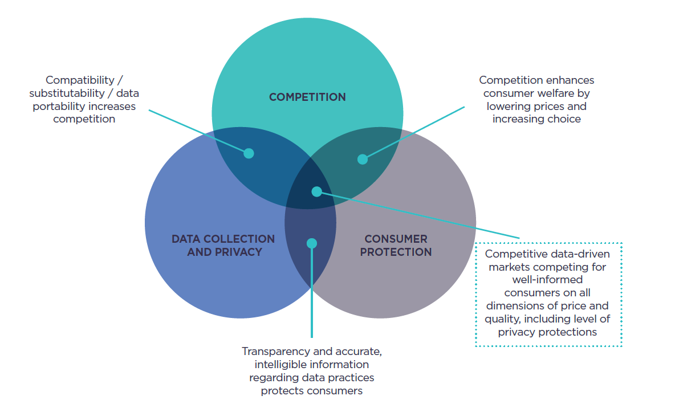
Final thoughts (1)
Findings and recommendations relate to: competition, consumer/data protection and media issues
But the issues are interconnected – a holistic view is important

Slide 39
Final thoughts (2)
These are global issues:
policy proposals in multiple countries
numerous competition, consumer and data protection investigations
Expect to see closer engagement between governments and regulatory authorities on these issues.

