Slide 1

Halfway there? Covid policy trade-offs to inform NZ's approach in 2021
Dave Heatley
Presentation to LEANZ, 17 December 2020
Views expressed are my own
Notes:
Just to be clear, I’m here in a personal capacity and not presenting the views of the Productivity Commission.

Slide 2
Presentation summary
What do we now know that we didn’t know back at the start?
Covid not well characterised as a simple health vs. the economy trade-off
Policy trade-offs are everywhere
we can expect further issues requiring difficult trade-offs
Good policy development acknowledges & addresses trade-offs
and uses the best analytical tools available to inform decision makers
Notes:
Half way there? 2020 was the year when the virus appeared & spread. 2021 will be the year of mass vaccination; we can hope for something close to normality by year’s end.
Covid can damage both health and the economy. A good health outcome appears to be necessary but not sufficient for a good economic outcome. The challenge is to choose policies that protect health at lowest economic cost.

Slide 3
What do we know now that we didn’t know back at the start of the pandemic?

Slide 4
It’s now clear that
Pandemic will run for years
most of the world’s population yet to be infected
Improved tech & knowledge of policy costs & effectiveness
lockdowns very costly, but so are uncontrolled outbreaks
better treatments, contact tracing & isolation
Borders are not impregnable
“elimination” has turned out to be a temporary state between ongoing outbreaks
NZ is not a global priority for early vaccine deployment
full vaccination is months to years away
Notes:
The NZ government has committed to purchasing some vaccine doses. However, on a global scale, it is difficult to argue that they are needed here before countries worse affected by the pandemic.
There are sill significant uncertainties around vaccines. These include efficacy, protective effect for non-vaccinated, duration of cover, side effects, and safety for groups not included in stage 3 trials. These uncertainties should reduce quickly now that distribution is underway.

Slide 5


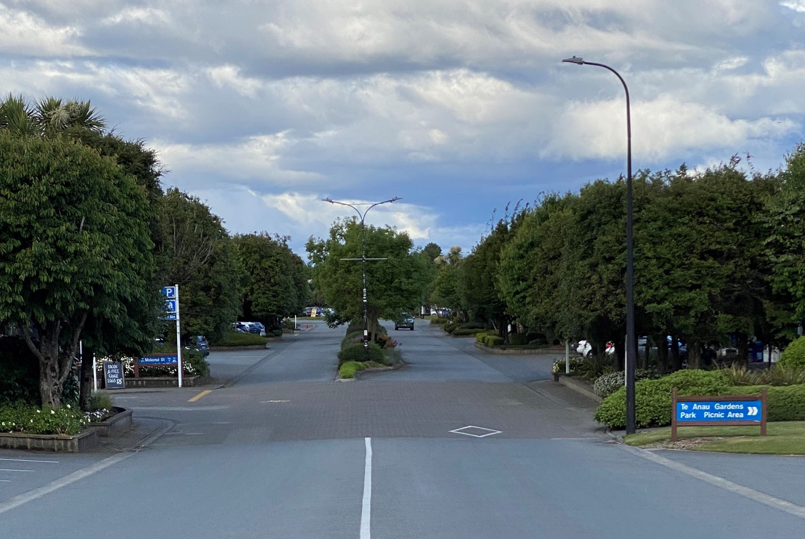

Uneven impacts: Wellington OK, South Island tourist towns not OK
Wellington 15 December
Wellington 23 March
Te Anau 5 December
Queenstown 3 December
Notes:
Wellington has returned to something like normality. This may be misleading for us Wellingtonians. The normally frantic tourist towns of Queenstown and Te Anau remain ghost towns.
[Explain pictures]

Slide 6
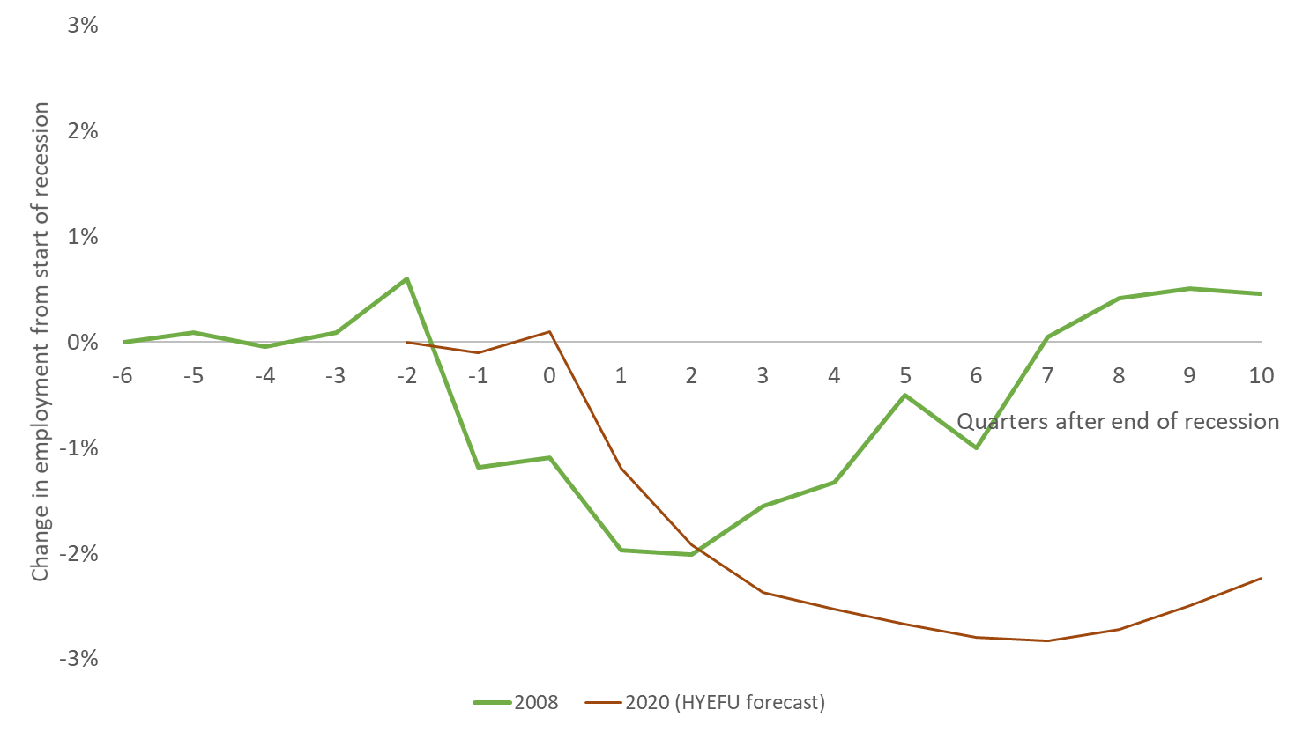
Worst yet to come? Employment bottoms out after recessions end
Economic (GDP) recession
Post-recession employment recovery
Notes:
We know from previous recessions that employment takes many quarters to recover AFTER the recession ends. The green line shows employment recovery after the 2008 recession – it took 1½ years for employment to return to pre-recession levels. The brown line shows yesterday’s Treasury forecasts. They forecast employment to bottom out in mid 2022 and only slowly recover thereafter.
The view from today suggests that the employment hit from Covid will be deeper and longer-lasting than that of the Global Financial Crisis.

Slide 7
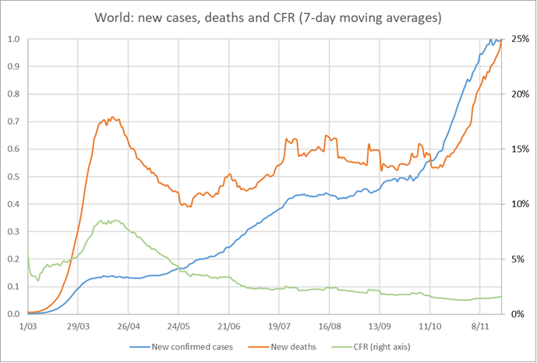
Covid is becoming less deadly:
The case fatality rate has fallen 2/3
Likely better treatment, & improved isolation of vulnerable populations
Notes:
On a more positive note, the Covid case fatality rate has dropped dramatically.
The blue line shows that Covid cases are peaking globally.
The orange line shows that Covid deaths are similarly peaking.
But the ratio of the two – the number of deaths per 100 cases – plotted here as a green line, has fallen significantly since its April peak.
Better treatment and improved isolation of the vulnerable are the most likely contributors to this improvement.

Slide 8
Covid policy is not a simple health vs. the economy trade-off

Slide 9
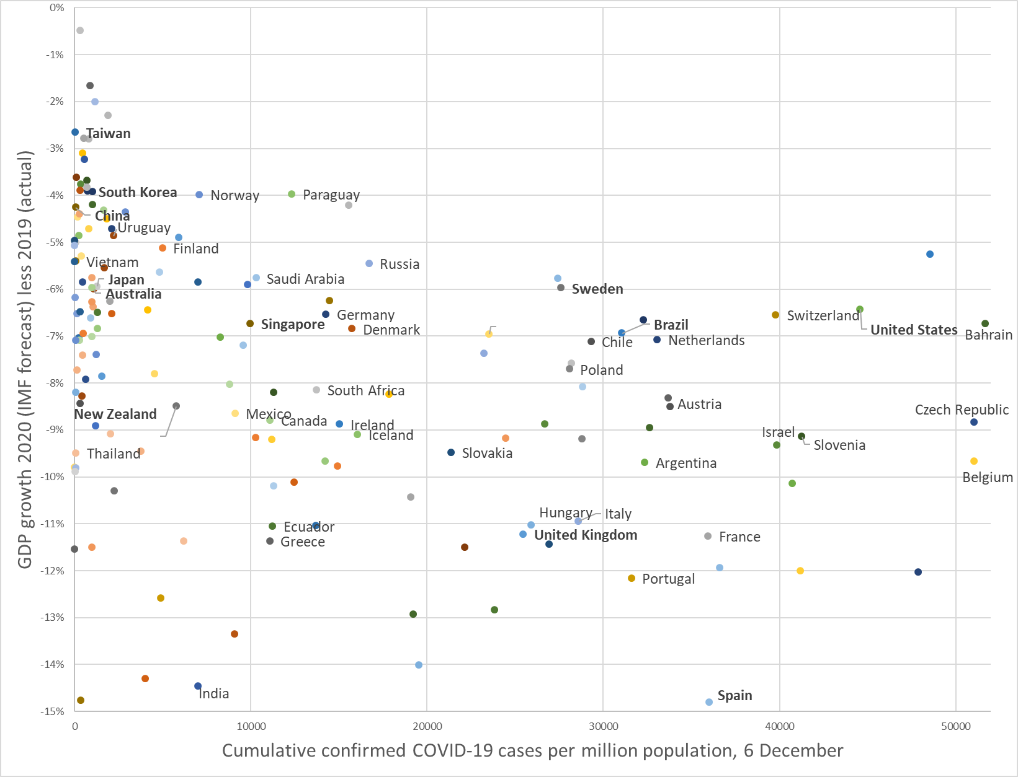
Covid trade-offs - examples
It’s not a health vs. the economy trade-off
Managing future lockdowns – asymmetry
What
Notes:
This graph shows most of the world’s countries.
The economies of those towards the top are doing well, and those towards the bottom are doing badly. Importantly, all countries are expected to do worse economically in 2020 than they did in 2019. Covid is costly.
Those on the left have performed best in controlling Covid, and those on the right have done poorly.
If countries’ policy choices reflected an inescapable trade-off between health vs. their economies, then countries would cluster along the dashed line.

Slide 10
Covid trade-offs - examples
It’s not get health right, and the economy will follow
Managing future lockdowns – asymmetry
What
Notes:
An alternative theory is that those countries that minimise Covid cases will suffer low economic costs, while those with high numbers of cases will bear the highest costs to their economies. The data does not provide much support for this theory.

Slide 11
Covid trade-offs - examples
The challenge is to protect health at lowest economic cost
Managing future lockdowns – asymmetry
What
Notes:
NZ is clearly doing better than the Czech Republic. But the best place to be is not where we are, it’s at the top left of this graph. Protecting health at lowest cost to the economy.
Other countries appear to be doing better than we are. I’ve highlighted Taiwan, South Korea, Japan and Australia. What can we learn from them?

Slide 12
To protect health at lowest economic cost, we need to acknowledge & manage policy trade-offs
We can anticipate many future policy decisions that will require trade-offs
Notes:
I’m now going to discuss a selection of issues that we can anticipate as requiring such decisions.

Slide 13
Time trade-offs: health costs now vs. health costs later
A health cost is an economic cost
An economic cost is a health cost
Lockdowns, border closures and social distancing have indirect health costs
Normal health economics practice is to quantify all such costs using quality-adjusted life years (QALYS)
Notes:
Looking across countries and across time, we know that
* a healthier population results in a healthier economy, & a healthy economy results in a healthier population
* richer countries can buy more and better health treatments
* unemployment is particularly negative for wellbeing (as are business failures)
Lockdowns, border closures and social distancing have indirect health costs
* These include delayed elective surgery, delayed diagnostic screening & direct mental health costs
We have tools for measuring the effects of pandemics and policies on health and the economy
* quantified health outcomes as value of a statistical life or quality-adjusted life years (QALYs)
* shadow prices on lives and health (e.g. transport decisions, drug purchasing)
If NZ is willing to spend $X to avoid the loss of a life or QALY then not having $X destroys NZ’s option to avoid the loss of a left or QALY

Slide 14
Border policy trade-offs
A partly closed border helps protect those in NZ
Current policy accepts some risk of Covid transmission, but doesn’t eliminate it
~11 outbreaks since July from the border into NZ community
1 of those outbreaks led to the Auckland lockdown (~$5bn cost)
Shorter stays in quarantine for those arriving from low-risk countries could lower costs for minimal increased transmission risk
Isolating at home could lower both risk and cost
quarantine is risky due to cross-infections
Notes:
A partly closed border is not ideal economically.
* rationing places is costly to citizens outside the country
* costly to businesses relying on overseas labour, tourism operators & exporters
* socially costly to NZers, including being costly to visit family overseas
- allowing people out after a negative day 3 test

Slide 15
Lockdown trade-offs
Future outbreaks are likely & rapid community transmission possible
lockdowns are a costly response, but are effective in reducing virus transmission
virus-spread uncertainty reduces quickly during a lockdown
Optimal policy includes
fast imposition (for a real possibility of uncontrolled virus spread)
quick release (once uncontrolled virus spread is unlikely)
The timing of release from lockdown is a trade-off
a certain cost from an extension vs. the cost of a re-imposition (if needed)

Slide 16
Information trade-offs
Single & consistent messaging encourages public compliance with virus-control measures & builds trust in government & “experts”
can be valuable in a crisis, but suppresses alternative ideas
Over the medium-to-long term, plurality of analysis & advice refined by contest and cooperation, finds the best solutions to complex problems
Notes:
NZ approach has leant towards single messaging over plurality
e.g. monopoly provision of modelling
Plurality is harder to “manage”, but offers better overall outcomes

Slide 17
Vaccine distribution trade-offs
The best strategy for distributing limited quantities depends on the circumstances a country faces
for most countries, it is health workers then the elderly
arguably NZ should start by using vaccines to help keep Covid out of the community
This suggests the first vaccines should go to border workers (quarantine staff, air crew, etc.)
they have the most contact with infected people
they are the most likely vector for future outbreaks
After the first round of vaccination, there are still trade-offs to be made
Notes:
A lot of people are thinking about vaccine allocation in terms of equity. Such allocation is a classic “allocation of a scarce resource” question, that is the natural domain of economics.
Vaccines confer a private benefit on their recipient AND a spillover benefit to others. Good policy reflects both these benefits.
Managed isolation and quarantine is costly for the state and for those quarantine
* vaccination before people depart for NZ would be much cheaper than MIQ (assuming vaccinated people are not a likely source of further infection)
* this could justify NZ paying to vaccinate those wishing to return
* NZ could charge for vaccinating outwards travellers that plan to return after their trip
There is a difficult trade-off here. Are we collectively better off vaccinating NZ’s international travellers than its nursing home residents?

Slide 18
What tools can better inform decisions with trade-offs?

Slide 19
Cost-benefit analysis is the gold standard
Difficult to apply quickly
but you can start early if you can anticipate needing to make a decision
CBA should consider real options if uncertainties are high
Can also use it ex post
learnings can inform future decisions
Cost effectiveness analysis also useful
but relies on the presumption that the goal is socially worthwhile
Multi-criteria analysis deals poorly with trade-offs
and is not replicable
Notes:
CBAs of course, only answer the specific question they are designed to address. So it is not necessarily valid to draw wider conclusions from them. That said, my own work on the release of the lockdown in April, Ian Harrison’s analysis of closing down the construction industry, & Martin Lally’s analyses all suggest that some opportunities to minimise economic costs have been missed.
CBAs require clearly specified options, and predictions of what will (or would have) happened. They are
inherently utilitarian – greatest good for the greatest number of people
inherently egalitarian – individuals are valued equally
should account for externalities, both positive and negative
based on the concept of economic welfare, wider than “the economy”
sums up the things people value, weighted by how much they value them
uses market prices where available, and shadow prices where not
shadow prices can be based on revealed or stated preferences
both costs & benefits need to be transformed to common units, typically monetary

Slide 20
Summary
Covid is both a health crisis and an economic crisis
these cannot be separated
optimal policy should address both
Publicly visible economic analysis of policy decisions has been limited to date
taken as a whole, they support the observation that NZ has incurred more costs than necessary in achieving its Covid-related health outcomes to date
Trade-offs haven’t gone away, we know at least some of those that are coming
We need to bring our best tools to bear on them, including cost-benefit analysis

Slide 21
Economic analyses of NZ Covid policy 1
Tony Blakely, Michael Baker & Nick Wilson (April 2020)
considering all differences in costs between attempted eradication versus flattening the curve … society might be prepared to spend up to $650 million to $2.48 billion more to ‘give eradication a go’ [Note: we’ve now spent much more than that!]
Bryce Wilkinson (April 2020)
spending 6.1% of annual GDP might be justified if it saved the 33 600 Covid-19 deaths epidemiologists advised the Ministry of Health could result were the pandemic left ’substantially uncontrolled’
Ian Harrison (April 2020)
CBA of closing down construction in March-April
estimated costs of $3bn for benefits of just $7.6m
Dave Heatley (May 2020)
ex ante CBA of decision to extend level 4 by 5 days
costs outweighed benefits by ~95:1
John Gibson (June 2020) observed differences in US states
Lockdowns achieved little more than private behaviour changes implying that NZ suffered large economic costs for little benefit in terms of lives saved

Slide 22
Economic analyses of NZ Covid policy 2
John Gibson (June 2020)
observed differences in US counties, implying that NZ suffered large economic costs for little benefit in terms of lives saved
Martin Lally (June-October 2020)
ex ante and ex post analyses show NZ policy decisions inconsistent with generally used values for a QALY
Davies & Grimes (August 2020)
largely theoretical exploration of real options analysis
Te Pūnaha Matatini (November 2020)
ex post cost-effectiveness analysis of the August Auckland level 3 lockdown in achieving a specified likelihood of elimination
a shorter level 4 had similar (near-term) economic costs

